Slide 1
Portfolio Construction
Reconstructing the Investico QQQ Trust ETF (QQQ)
Individual Equity Tickers: [MSFT, AAPL, AMZN, TSLA, GOOGL, FB, NVDA, GOOG, ADBE, NFLX, CMCSA, CSCO, PYPL, PEP, AVGO, COST, INTC, QCOM, TXN, AMD, INTU, HON, TMUS, AMAT, SBUX]

Slide 2
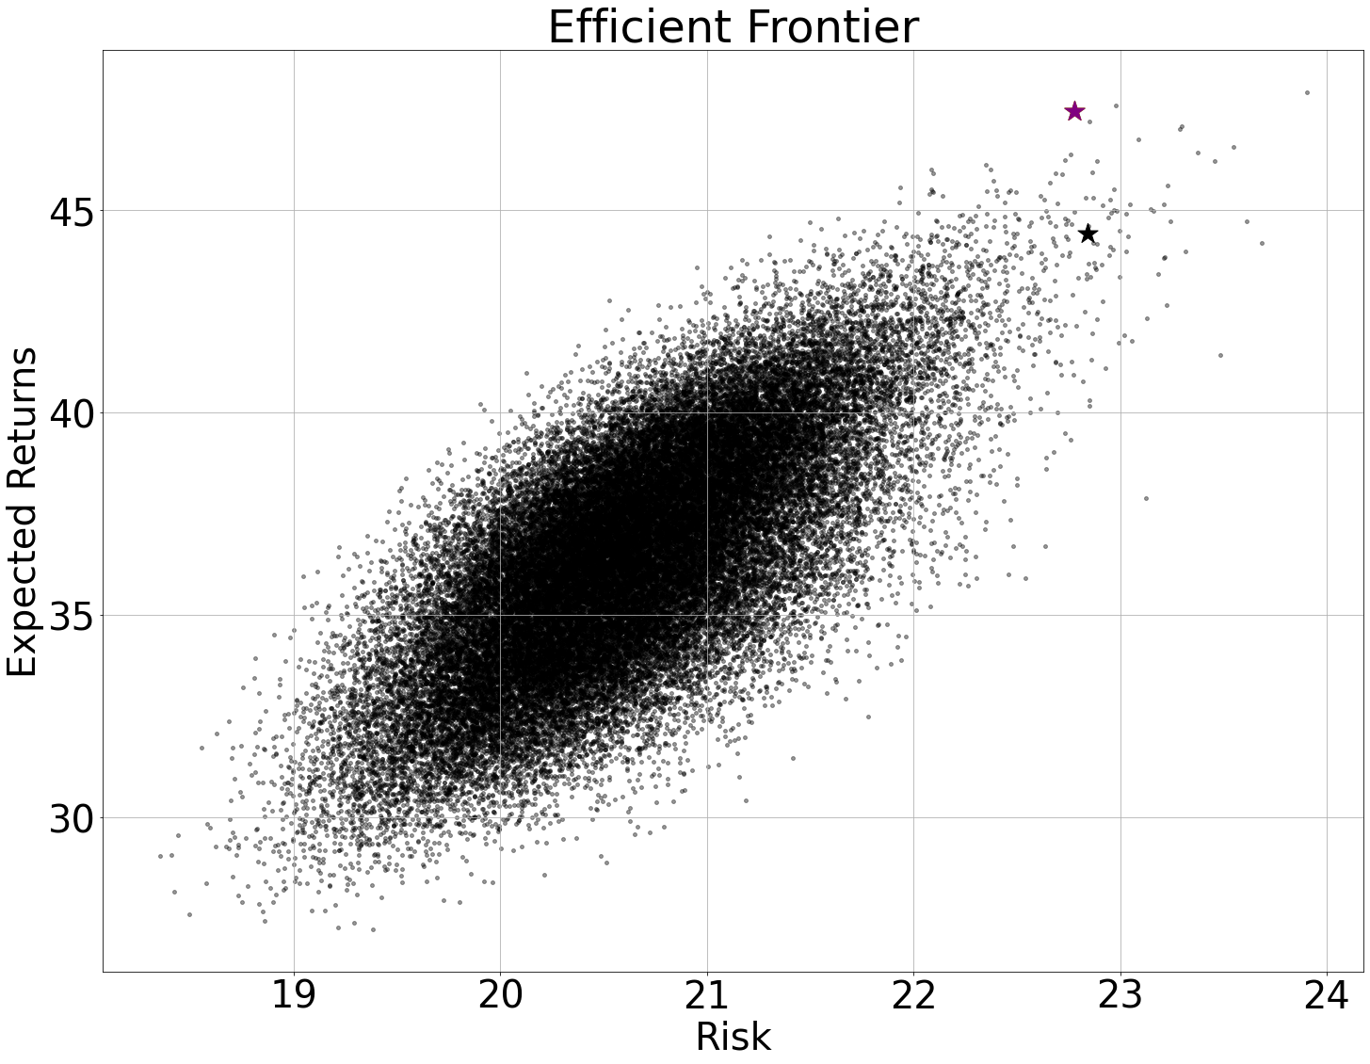
Modern Portfolio Theory
Markowitz's modern portfolio theory states that securities have either high risk and high return or low risk and low return
He argued that an optimal mix of assets exists based on their individual historical risk and return profiles
Markowitz's stated that diversified portfolios can offer greater returns for the level of risk an investor is willing to take

Slide 3
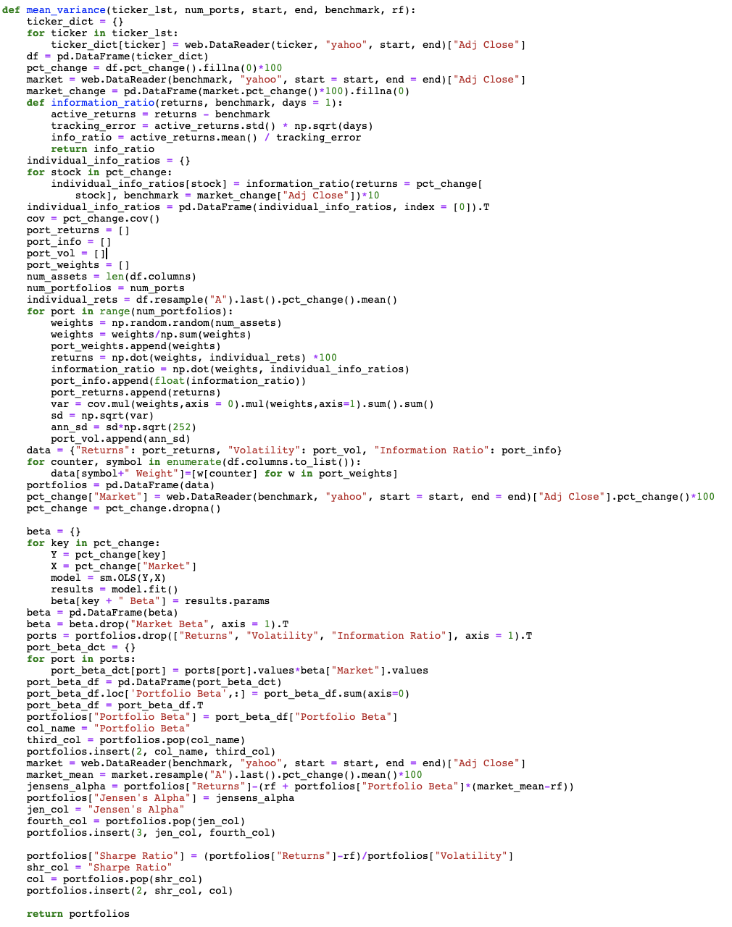
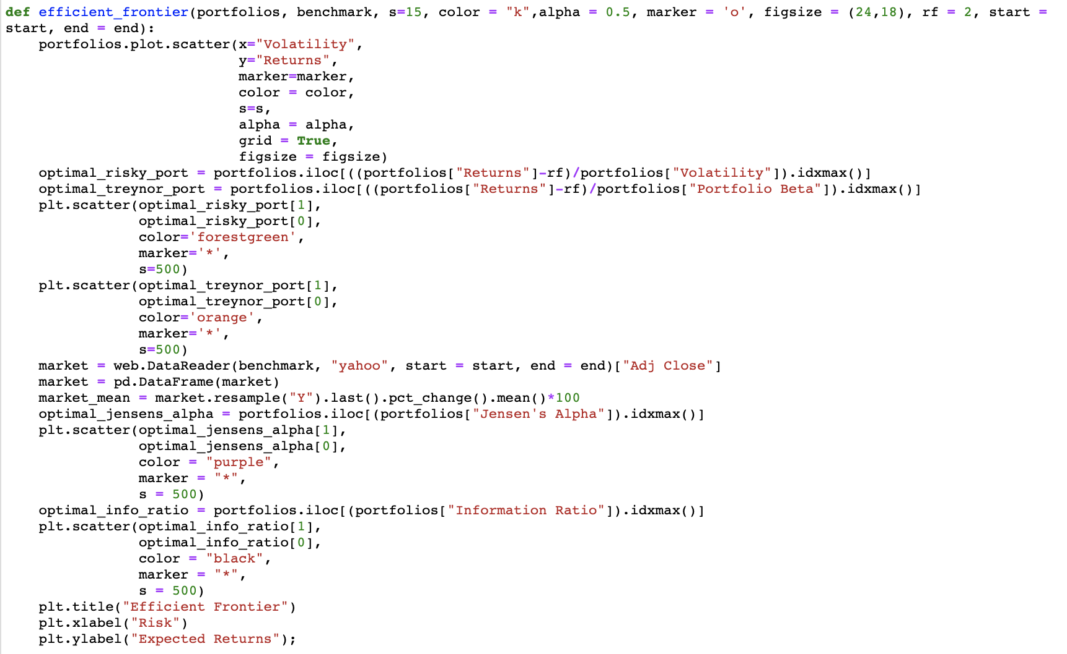
How I Generated the Efficient Frontier

Slide 4
Capital Asset Pricing Model
Developed by William Sharpe, Jack Treynor, John Lintner, and Jan Mossin the Capital Asset Pricing Model(CAPM), states that not all risks should affect asset prices
CAPM says that if a risk can be diversified away when held with other assets then that risk is no longer a real risk to the portfolio. Market risk is a risk that you cannot remove from any portfolio that operates within a market
E(R) = α + β(E(R_{market}) - R_{risk-free rate})

Slide 5
Capital Asset Pricing Model – Sharpe Ratio
Sharpe Ratio = (R_{Portfolio} - R_{risk-free rate})/σ_{Portfolio}
Analyzes the risk-adjusted return of a security or portfolio and helps to explain how, in a way how much risk has been diversified away by in your portfolio
Within the efficient frontier there is one portfolio that has the highest Sharpe Ratio but for many investors that portfolio may not align with their overall risk tolerance
However, any point along the curve provides the highest possible return for the investors risk tolerance
By simply using this line of code, portfolios.iloc[((portfolios["Returns"]-rf)/portfolios["Volatility"]).idxmax()], I was able to pull the highest Sharpe Ratio

Slide 6
Capital Asset Pricing Model – Treynor Ratio
Treynor Ratio = (R_{Portfolio} - R_{risk-free rate})/ β_{Portfolio}
The important distinction between this and the Sharpe Ratio is that this uses the portfolio beta instead of volatility to measure risk-adjusted return
To calculate the portfolio beta, I took the individual stocks periodical beta to the benchmark (QQQ in this case) and multiplied them by their weights
Higher the beta the more aggressive the portfolio is against the market/benchmark
Denoted by the orange star in the efficient frontier it happens to be the same portfolio as the portfolio with the highest Sharpe Ratio

Slide 7
Capital Asset Pricing Model – Jensen’s Alpha
Jensen's Alpha = R_{Portfolio} - (R_{risk-free rate} + β(R_{Market} - R_{risk-free rate})
Describes how much more or less your portfolio was able to generate above or below your benchmark
Commonly used for active portfolio managers to generate higher returns than the market
In my opinion Jensen’s Alpha is very hard to consistently achieve in the long run
Note that a higher beta to the benchmark will be captured in Jensen’s Alpha and generally has higher volatility which is consistent with EMH

Slide 8
Information Ratio
Information Ratio = μ_{(RPortfolio-RBenchmark)} / σ_{(RPortfolio-RBenchmark)}
Where Sharpe Ratio and Treynor Ratio explain risk-adjusted return the information ratio measures the performance of a portfolio in relation with the benchmark
High information ratios mean that the portfolio, on average over the period, has higher active return and low tracking error
Note that portfolio beta and volatility is higher than in the optimal Sharpe Ratio portfolio and Treynor Ratio portfolio

Slide 9
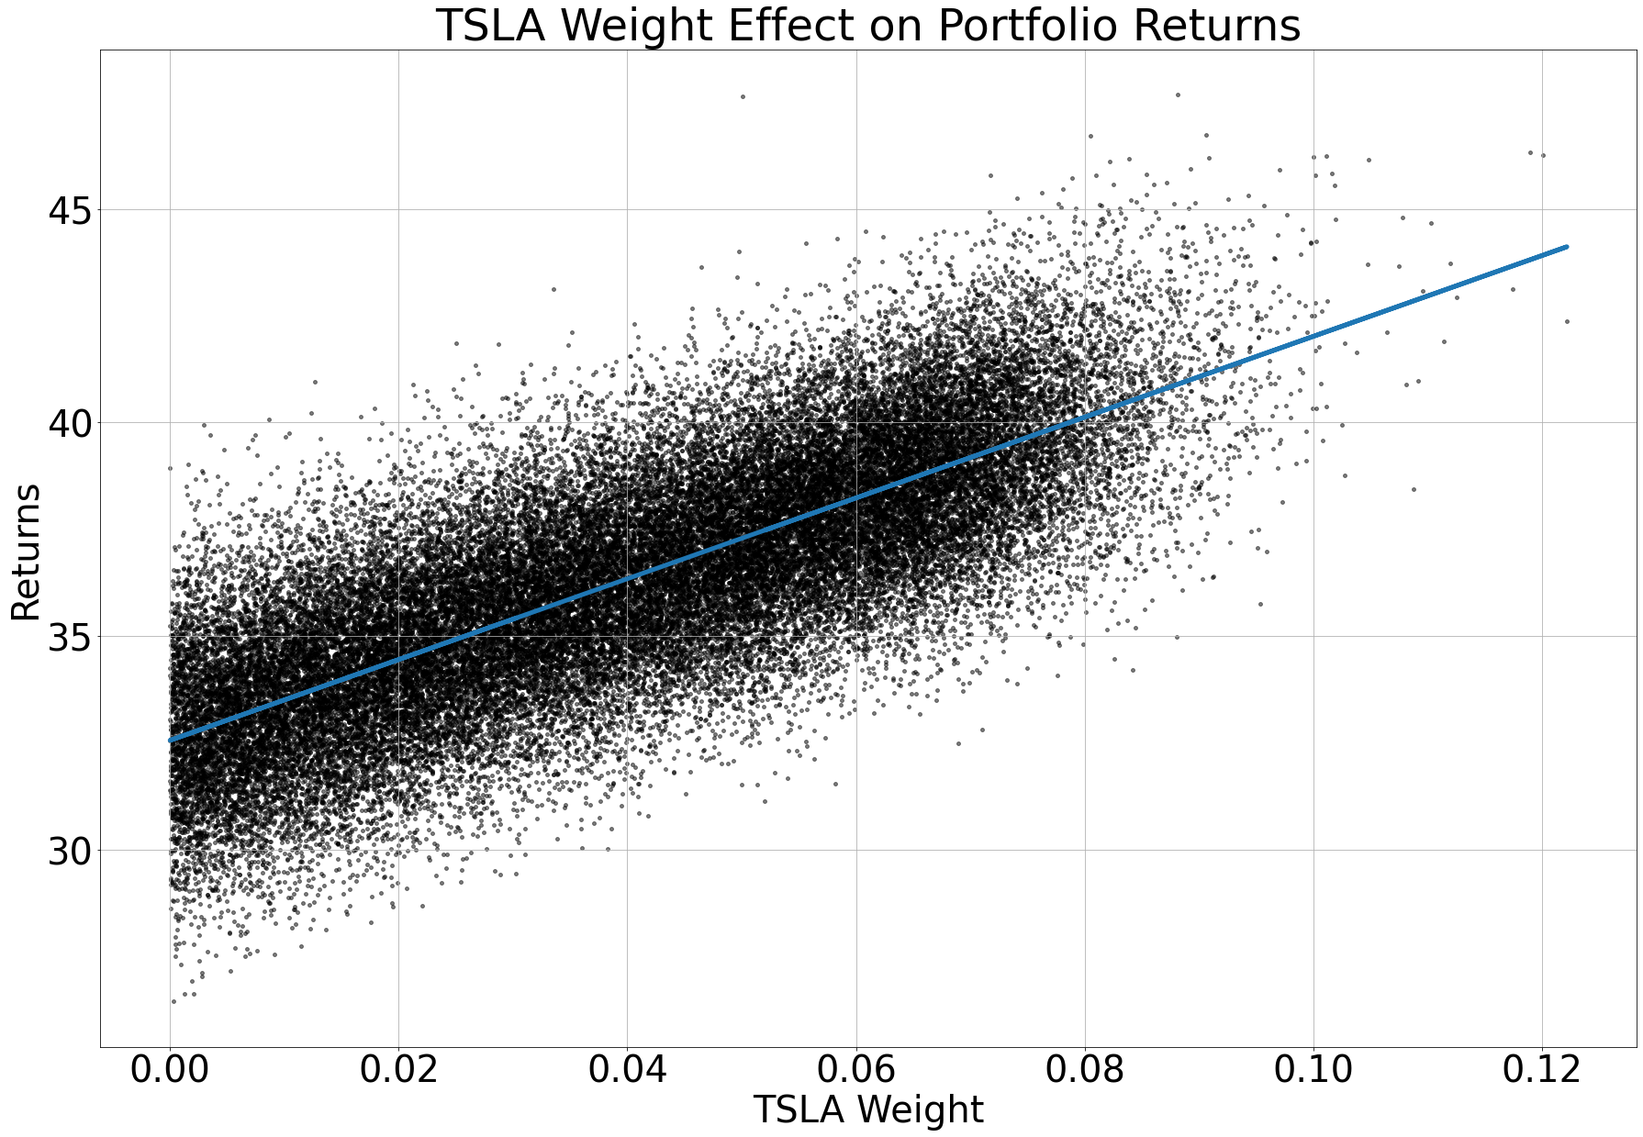
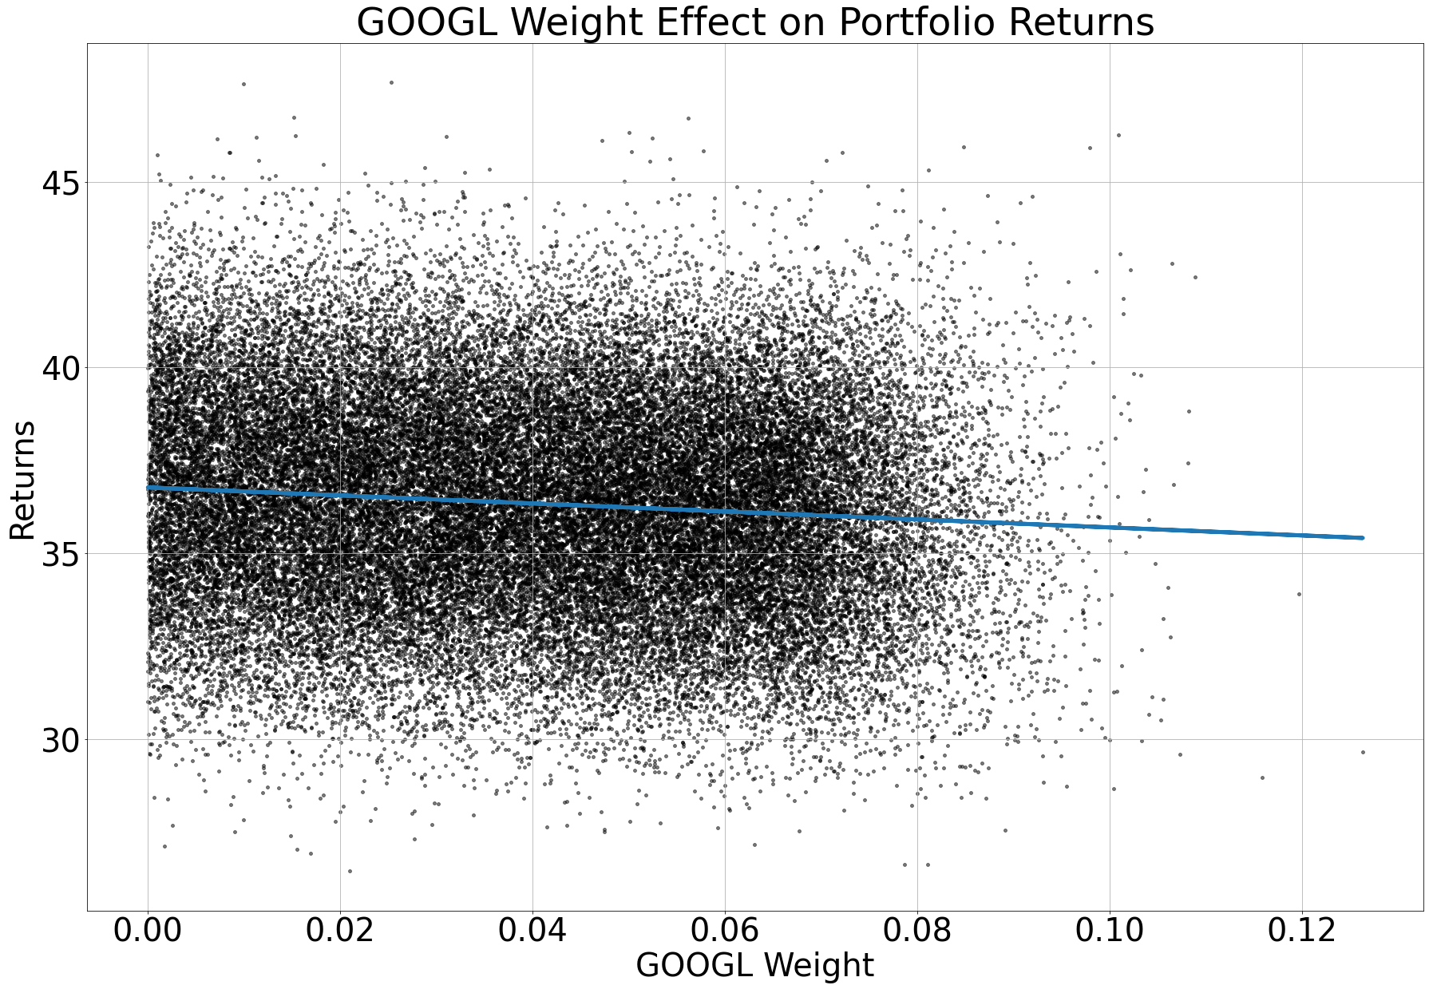
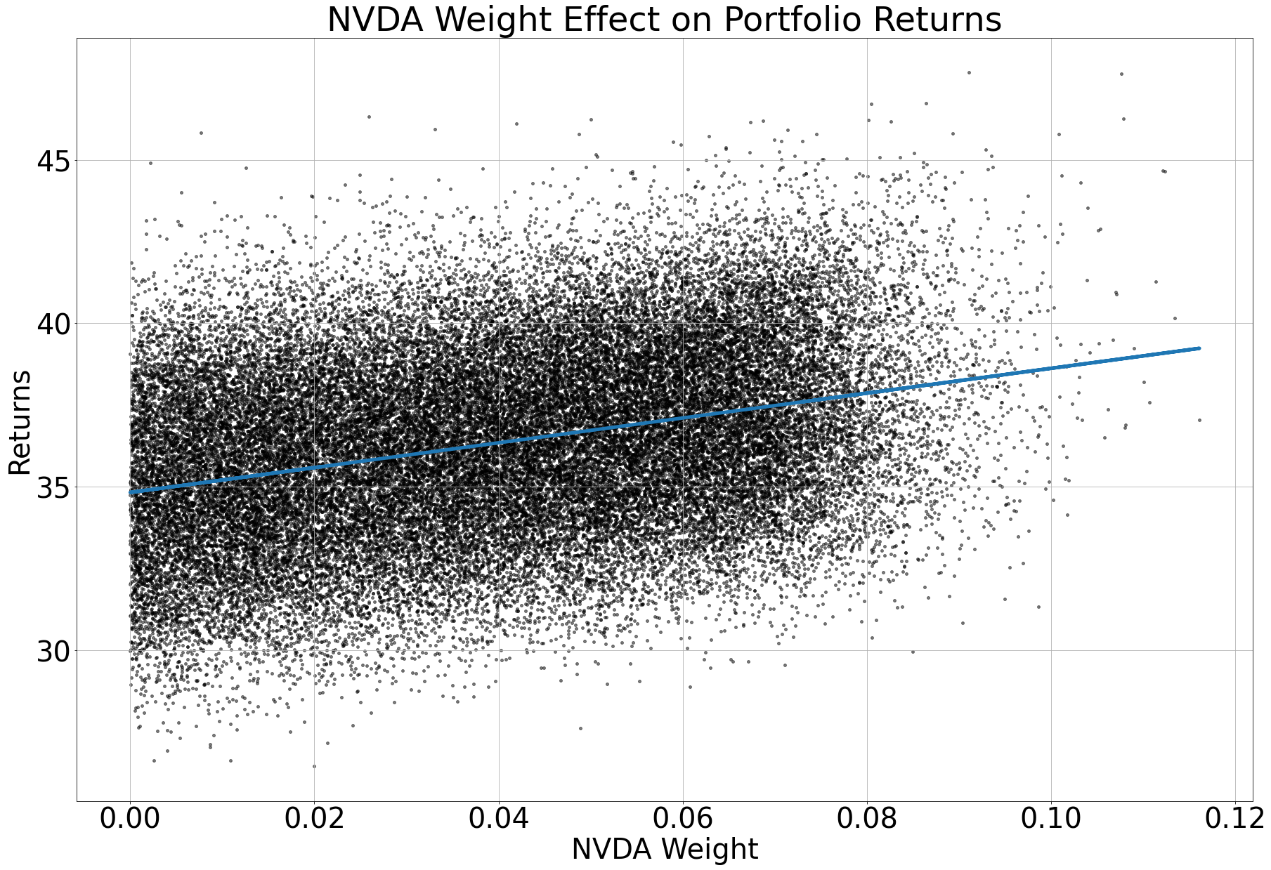
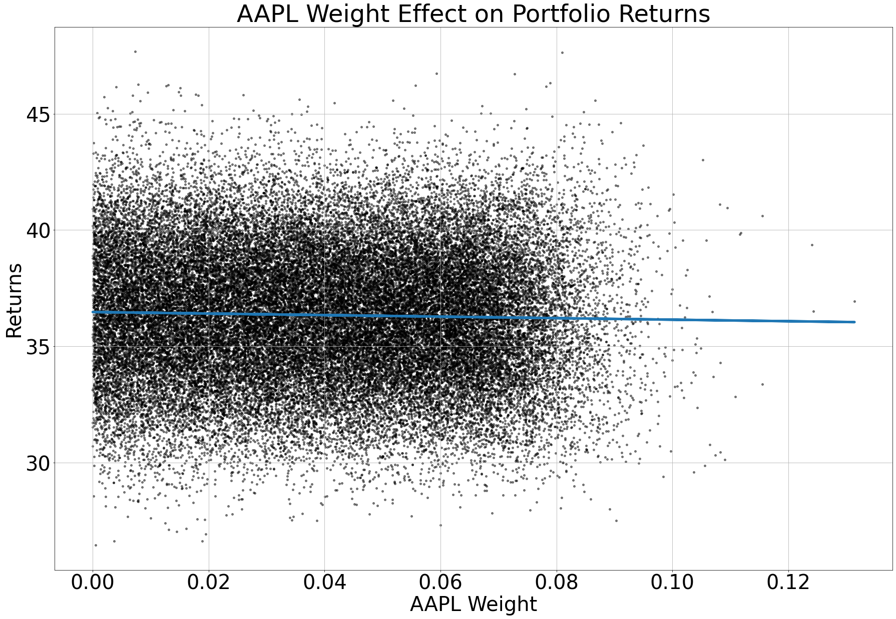
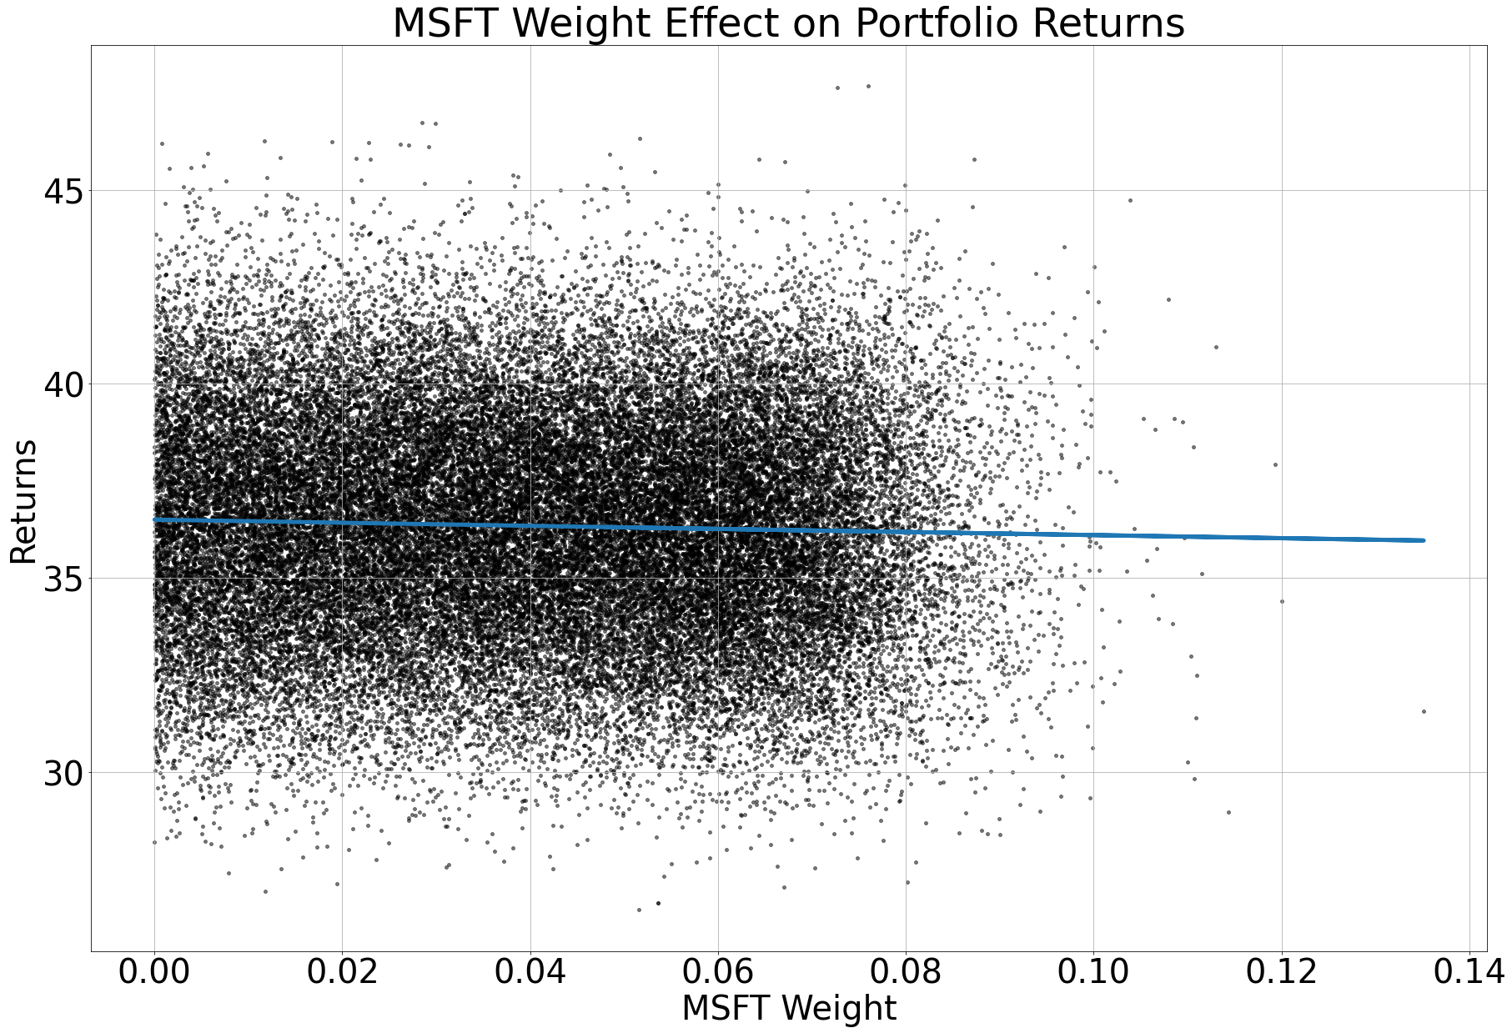
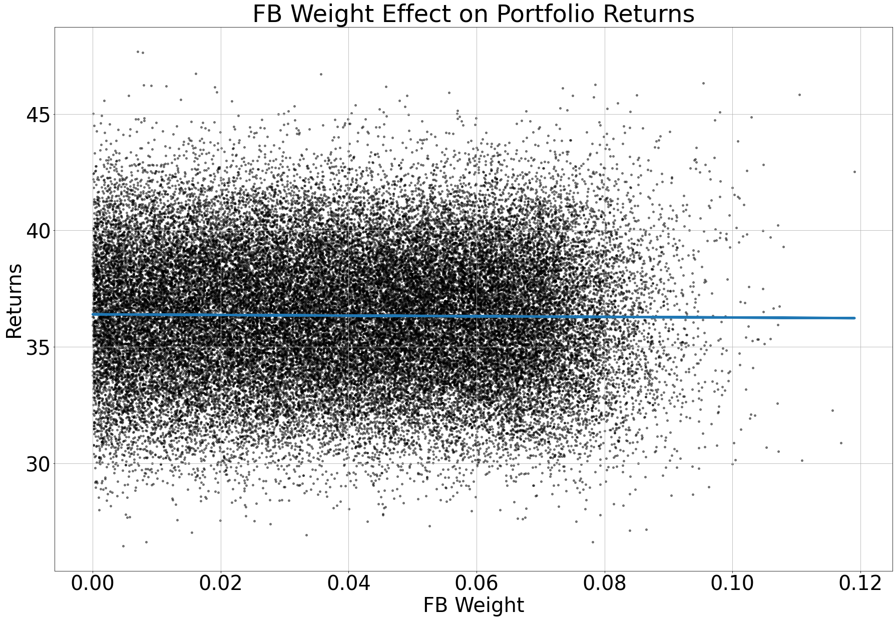
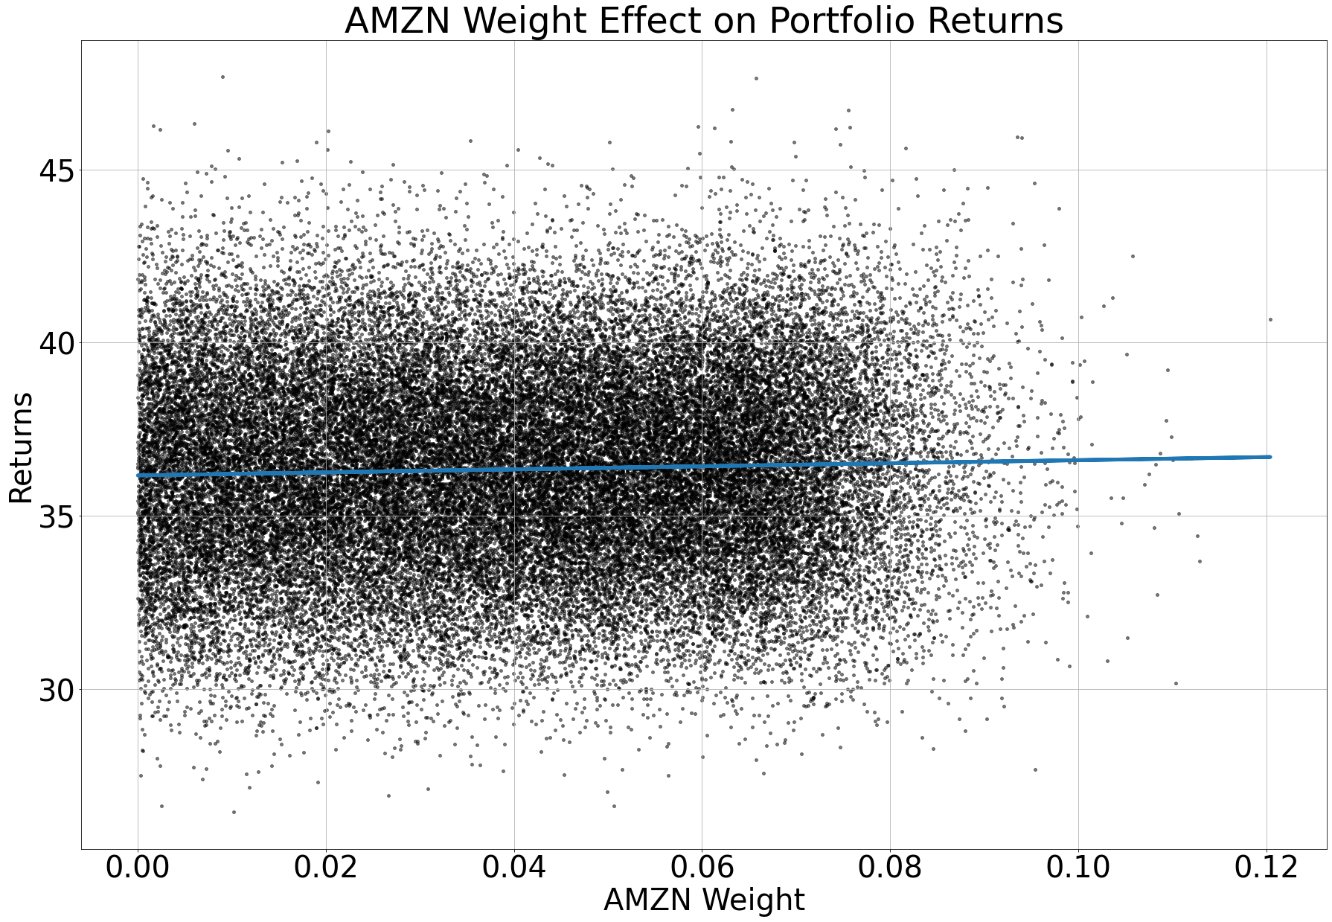
Individual Stock Effects on Returns
Understanding how additional weights adds to portfolio returns
As you can see TSLA has a large effect on the returns which also makes every other position have less of an effect on return
Though other positions still have an effect on return

Slide 10
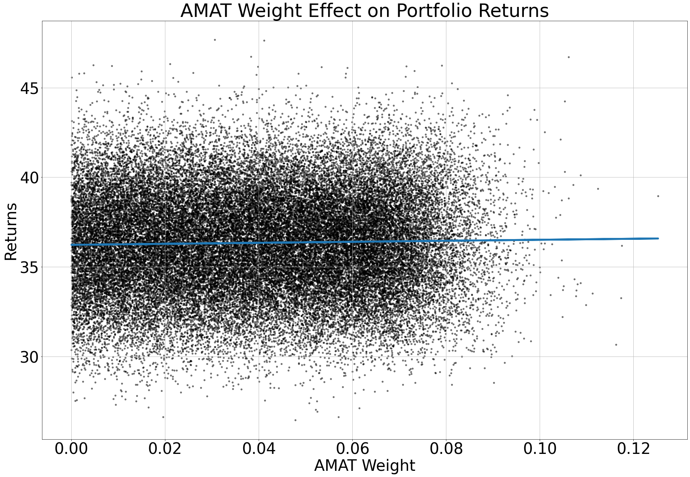
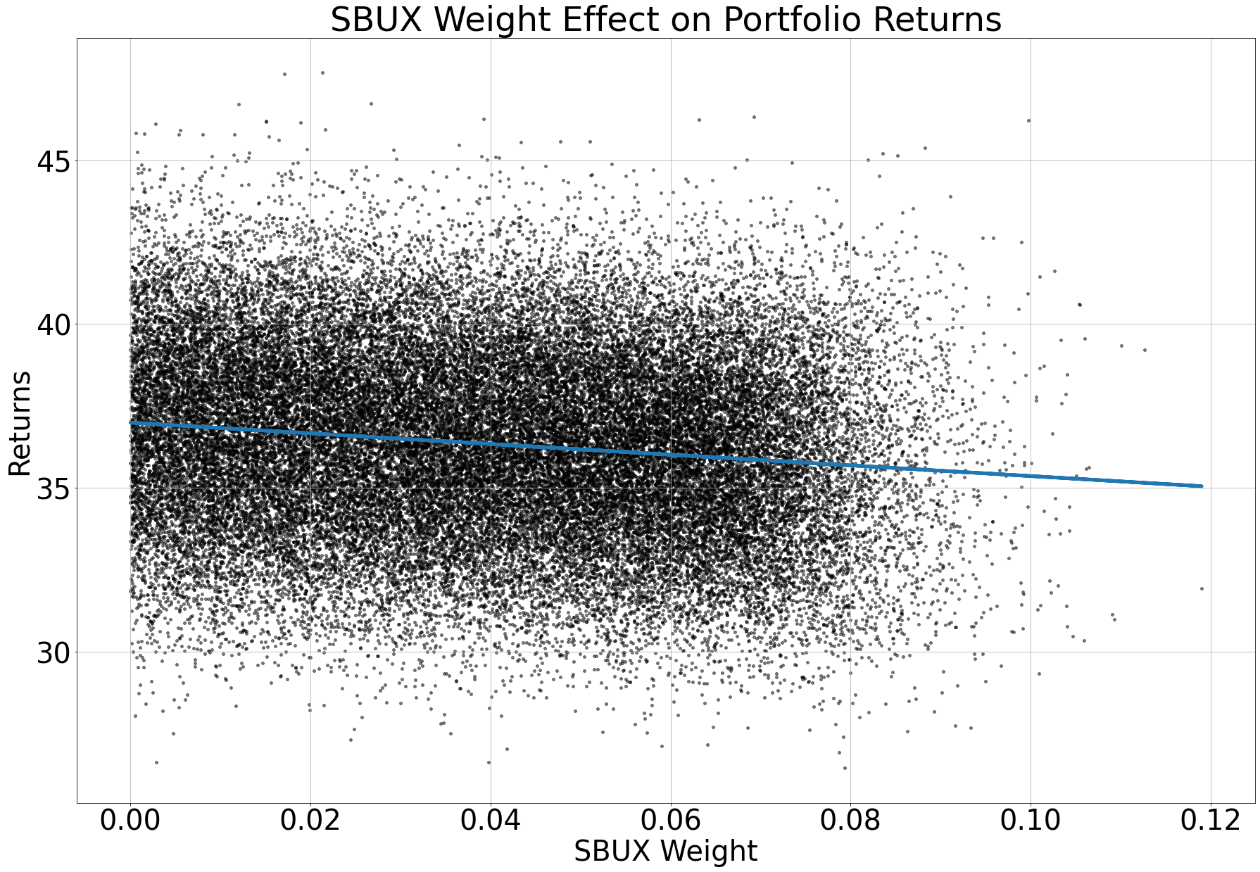
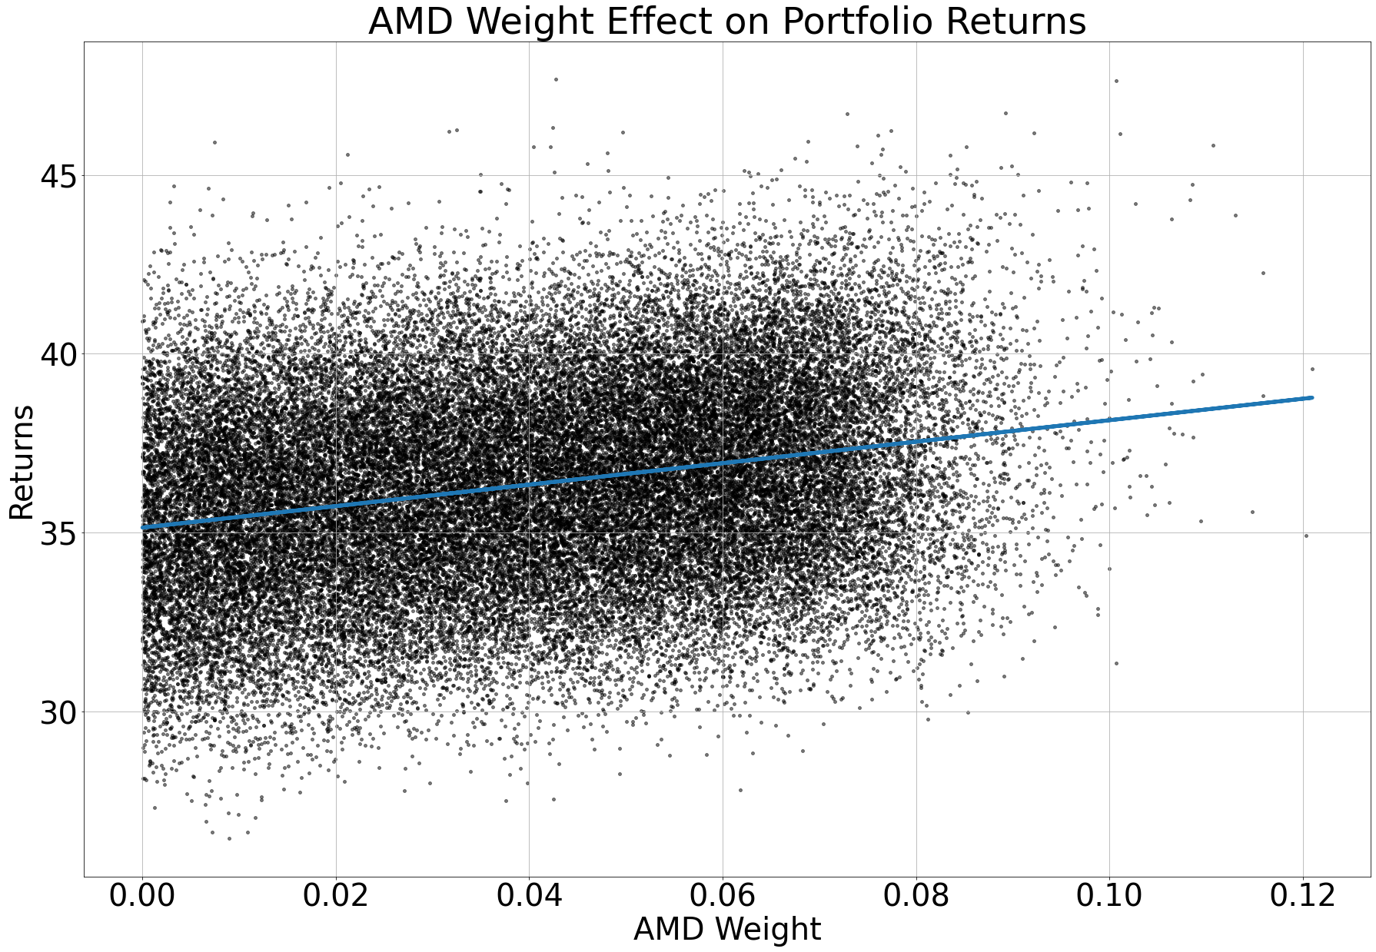
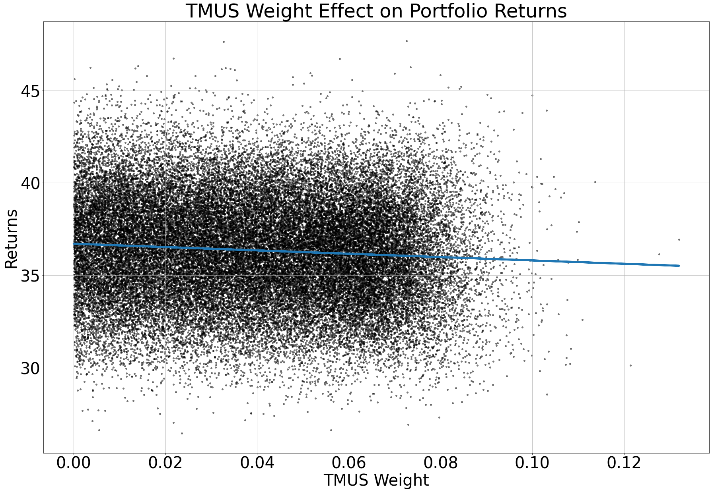
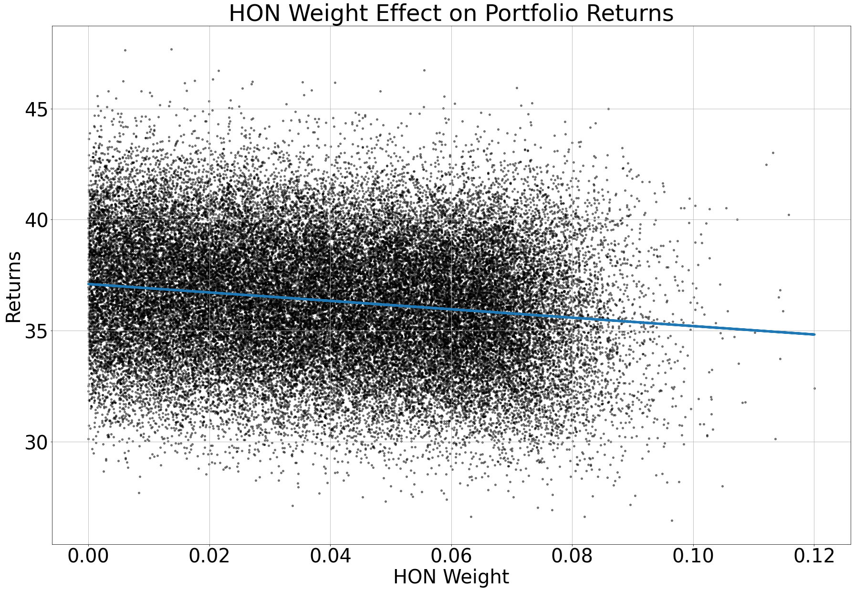
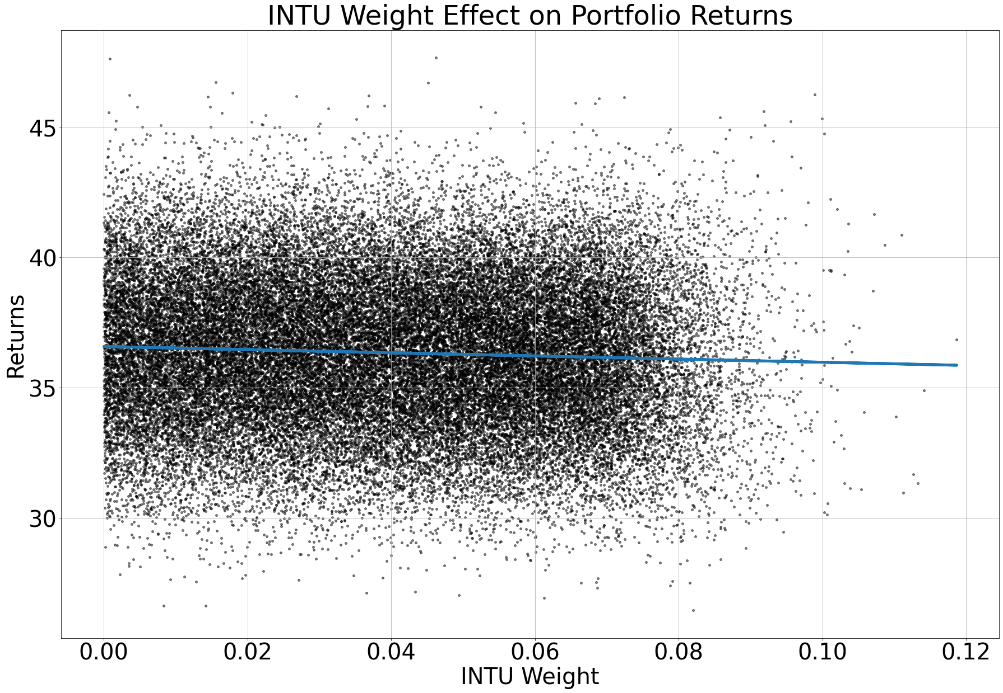
Individual Stock Effects on Returns
Understanding how additional weights adds to portfolio returns
As you can see TSLA has a large effect on the returns which also makes every other position have less of an effect on return
Though other positions still have an effect on return

Slide 11
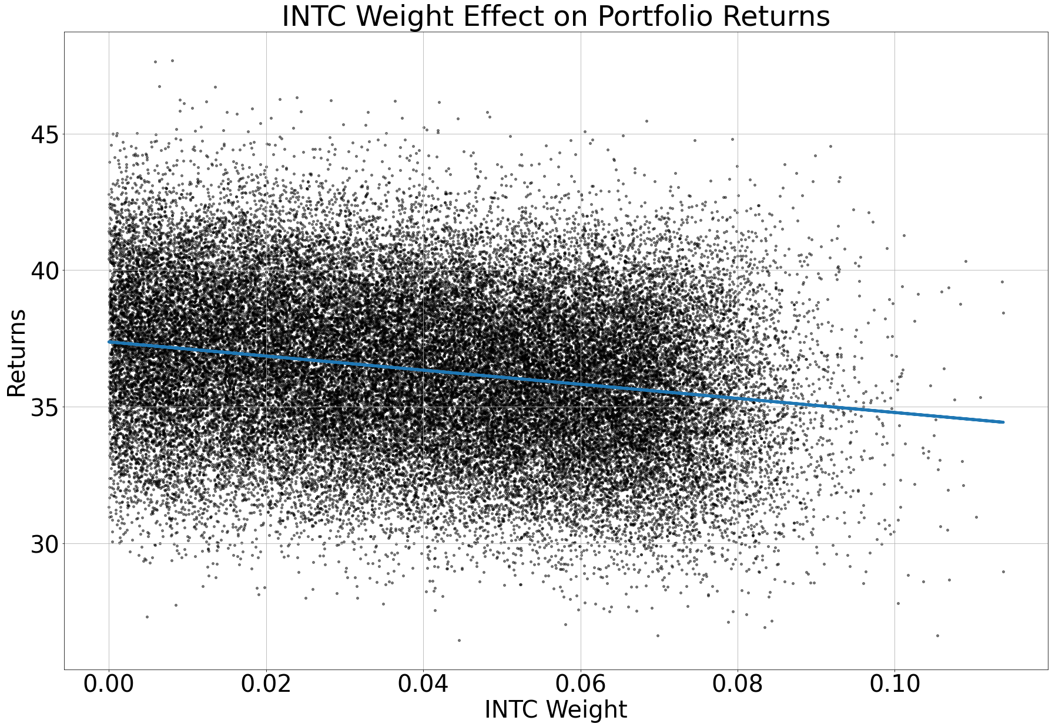
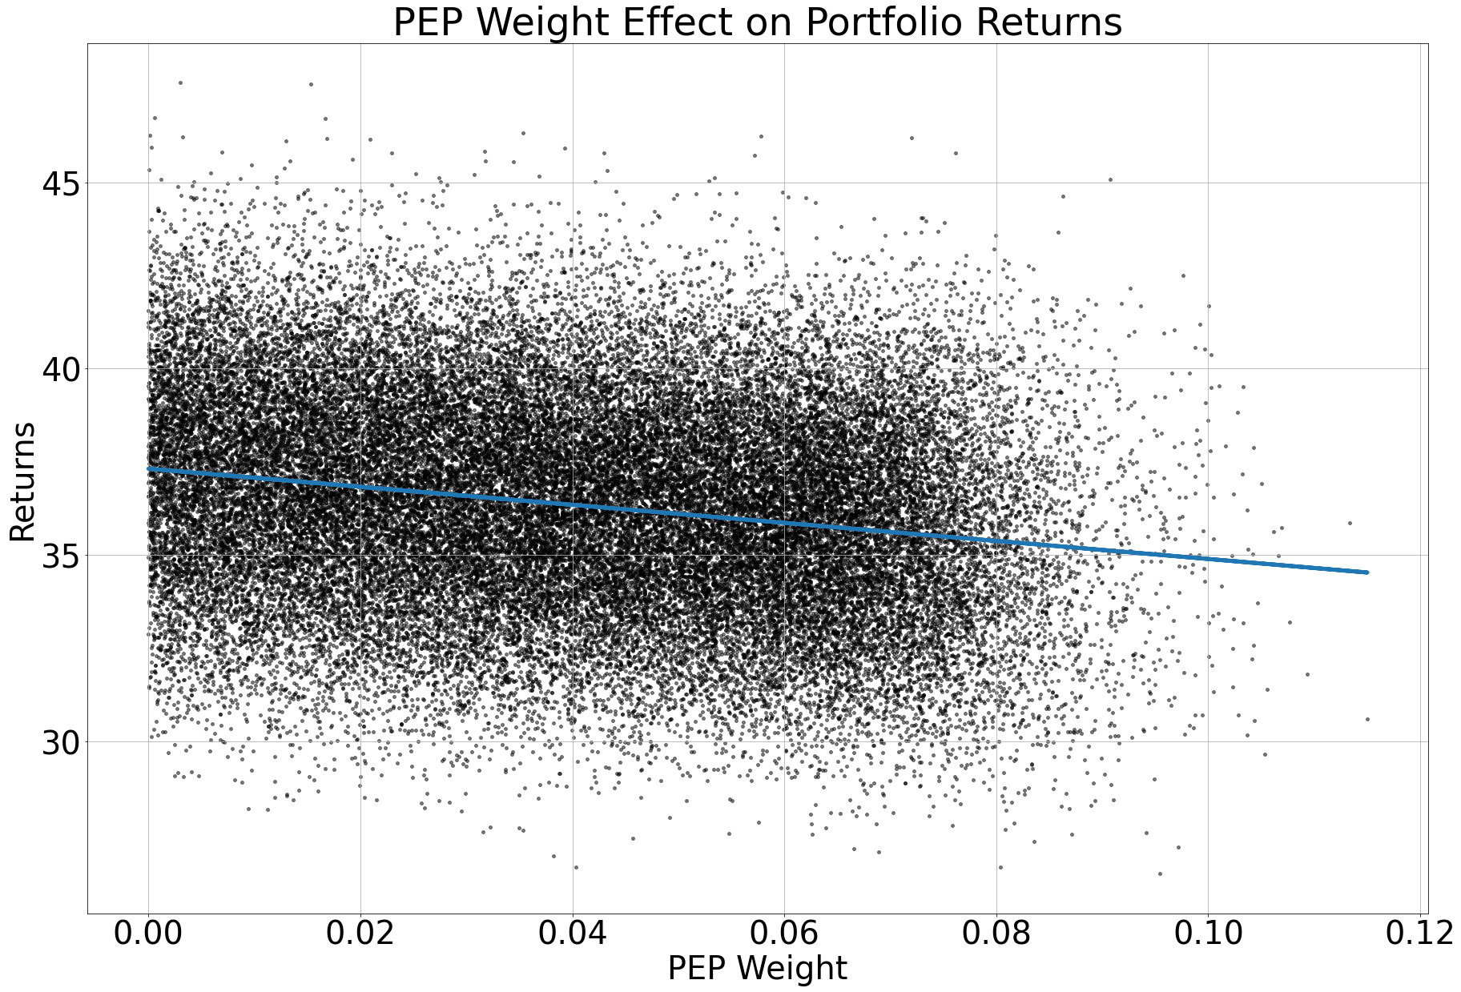

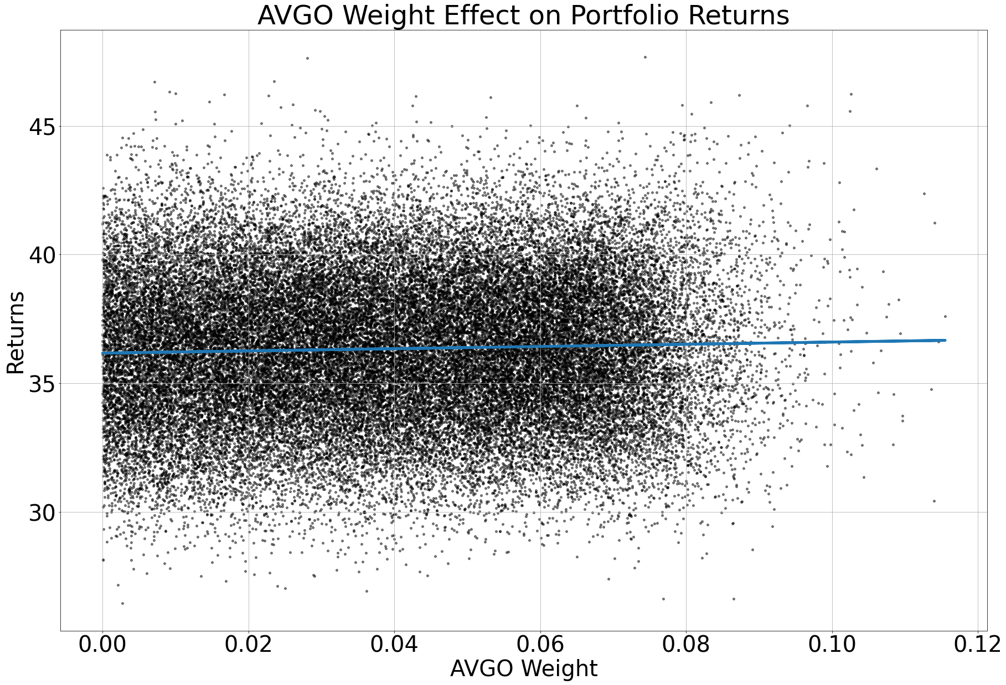
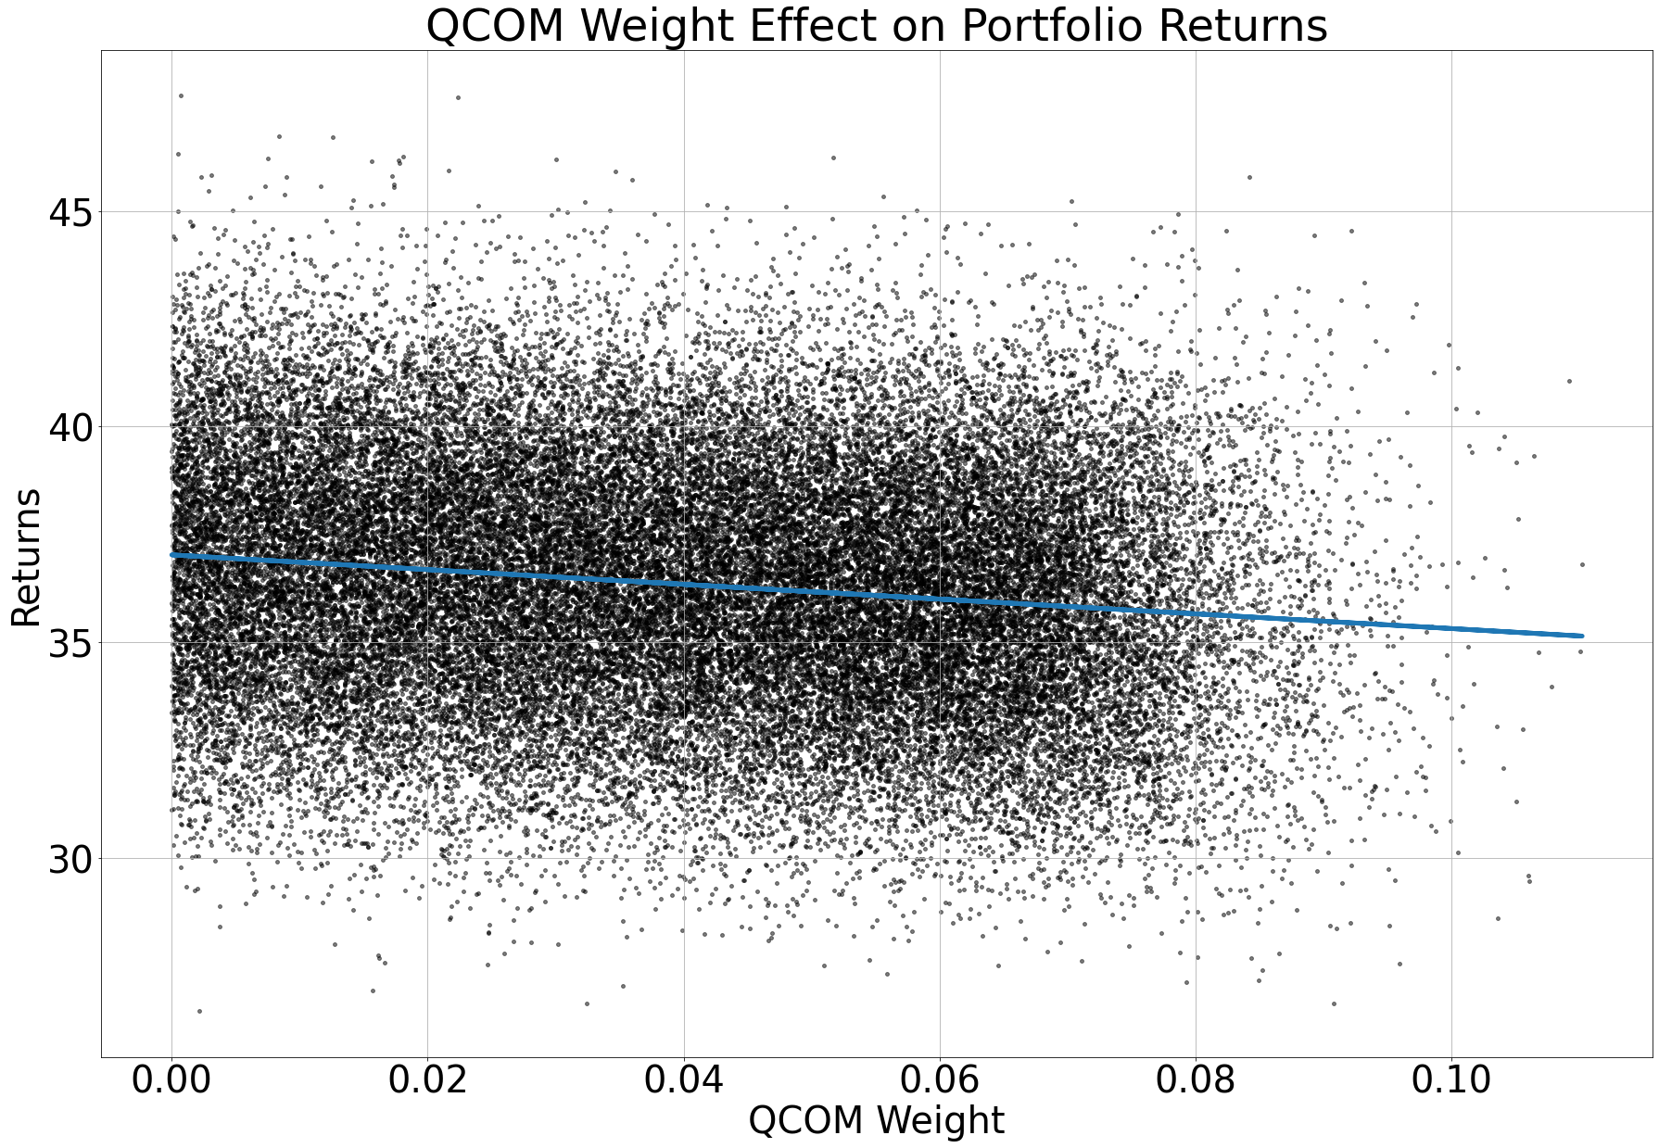
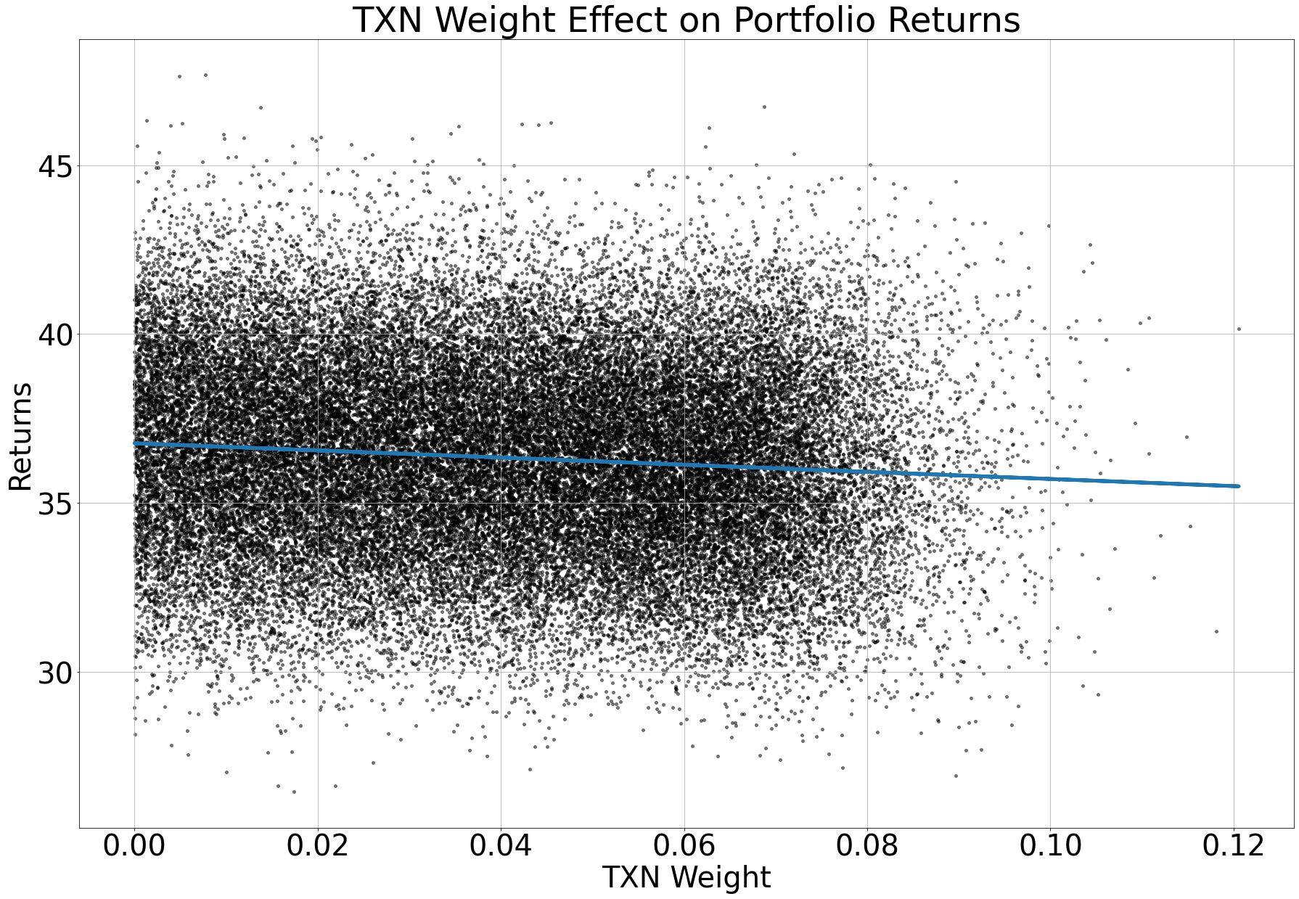
Individual Stock Effects on Returns
Understanding how additional weights adds to portfolio returns
As you can see TSLA has a large effect on the returns which also makes every other position have less of an effect on return
Though other positions still have an effect on return

Slide 12
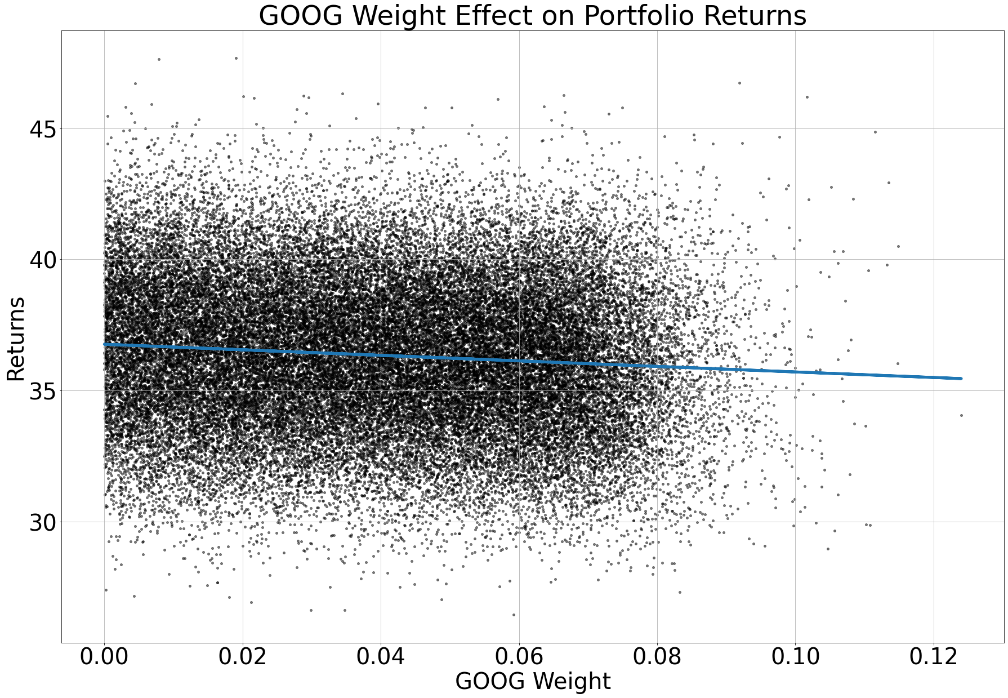

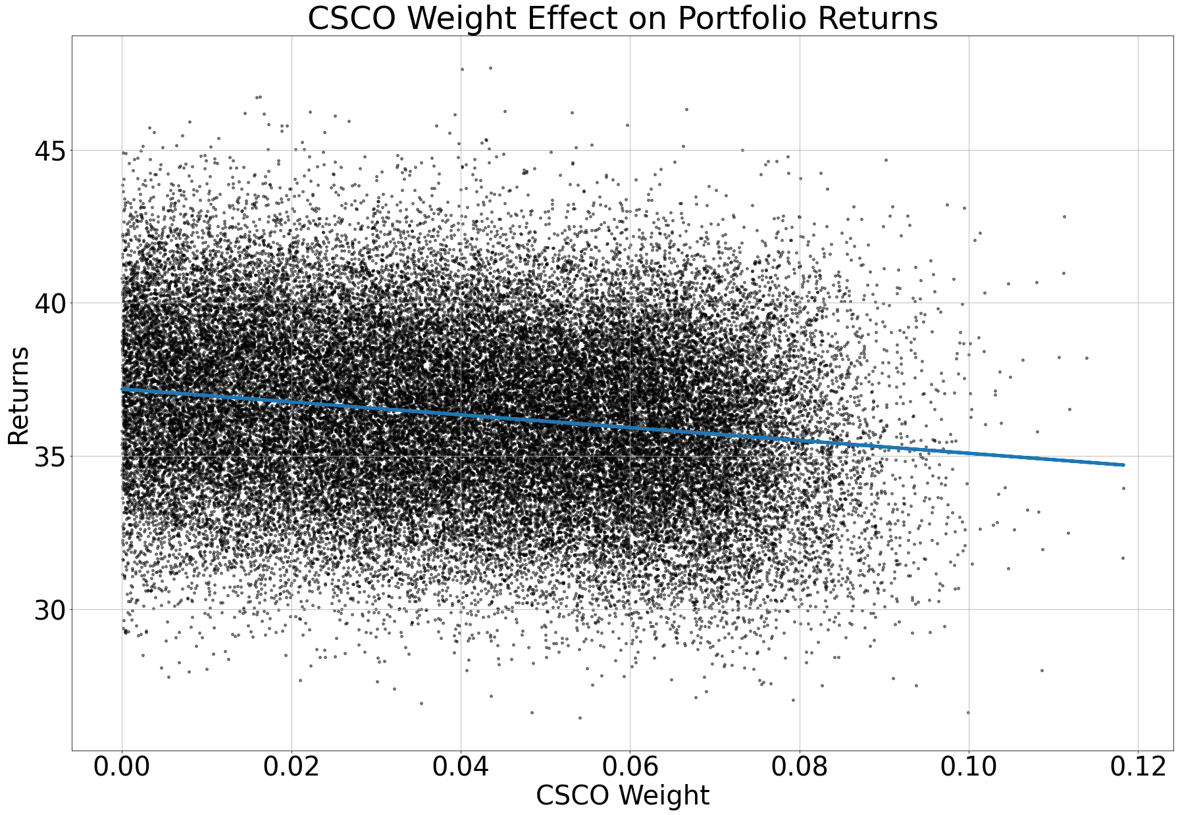
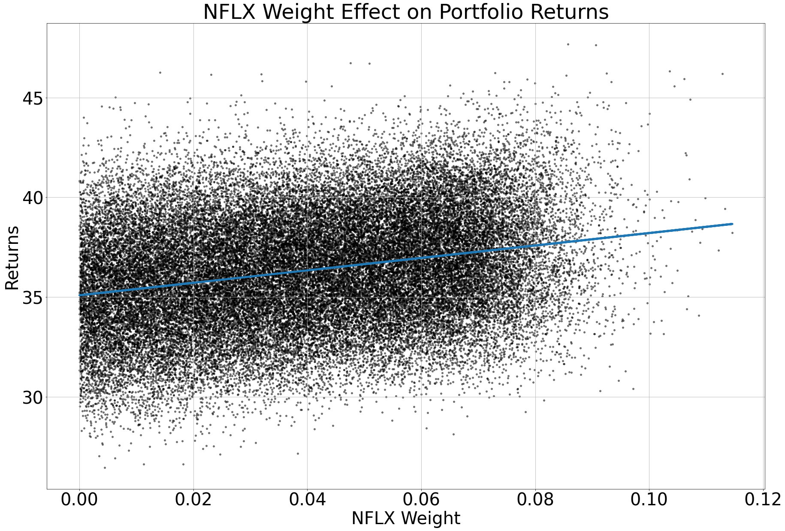
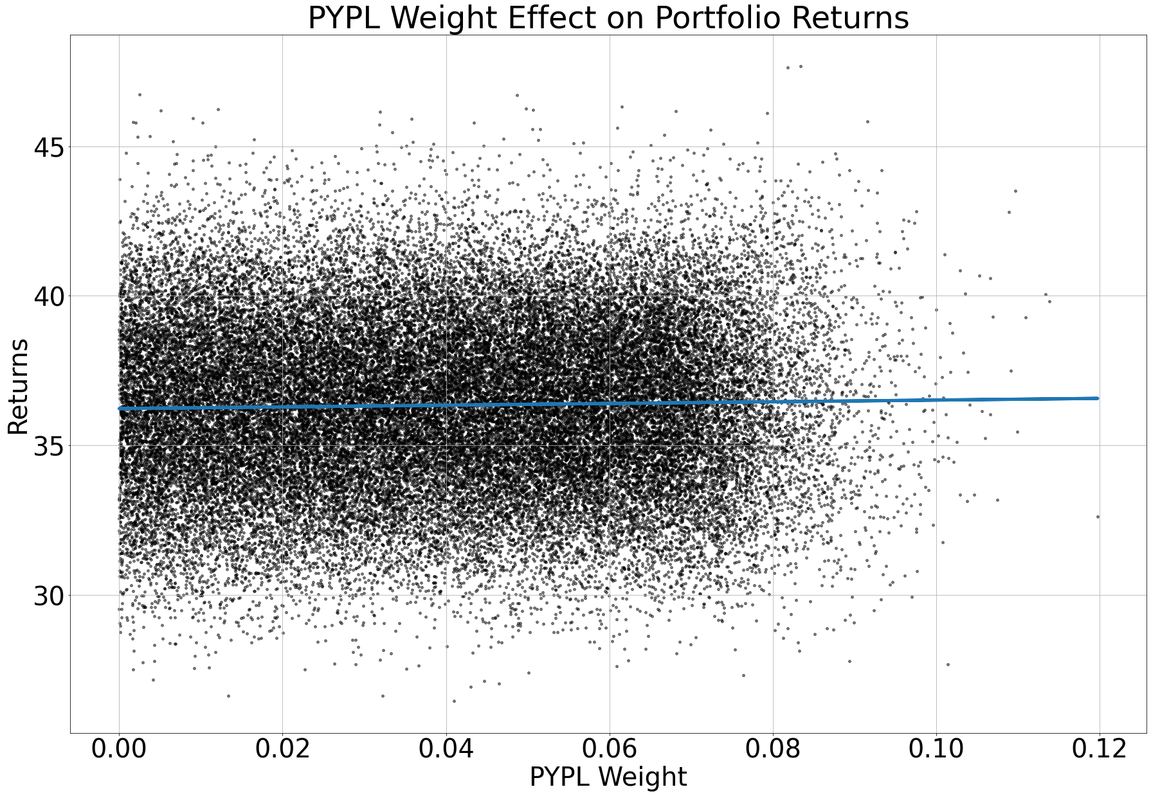
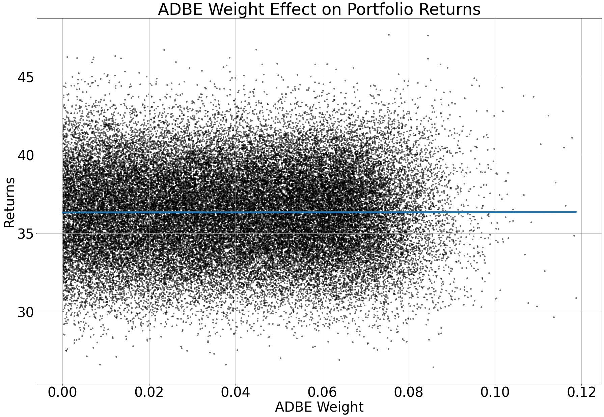
Individual Stock Effects on Returns
Understanding how additional weights adds to portfolio returns
As you can see TSLA has a large effect on the returns which also makes every other position have less of an effect on return
Though other positions still have an effect on return

Slide 13
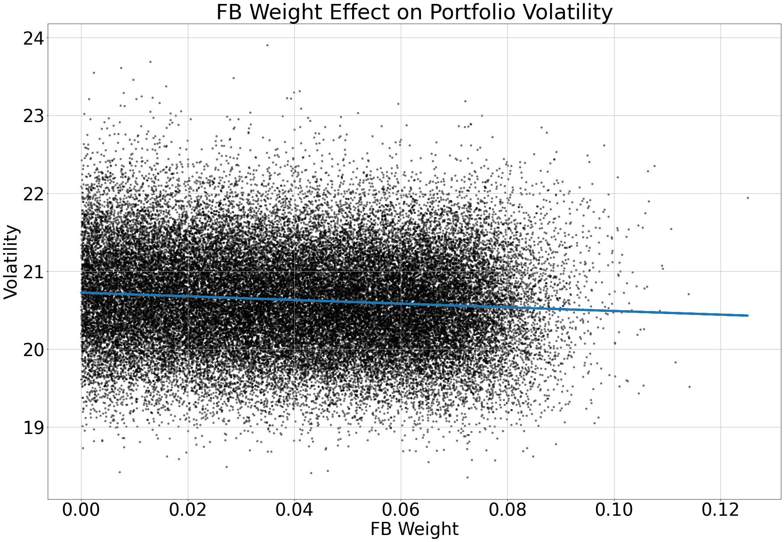
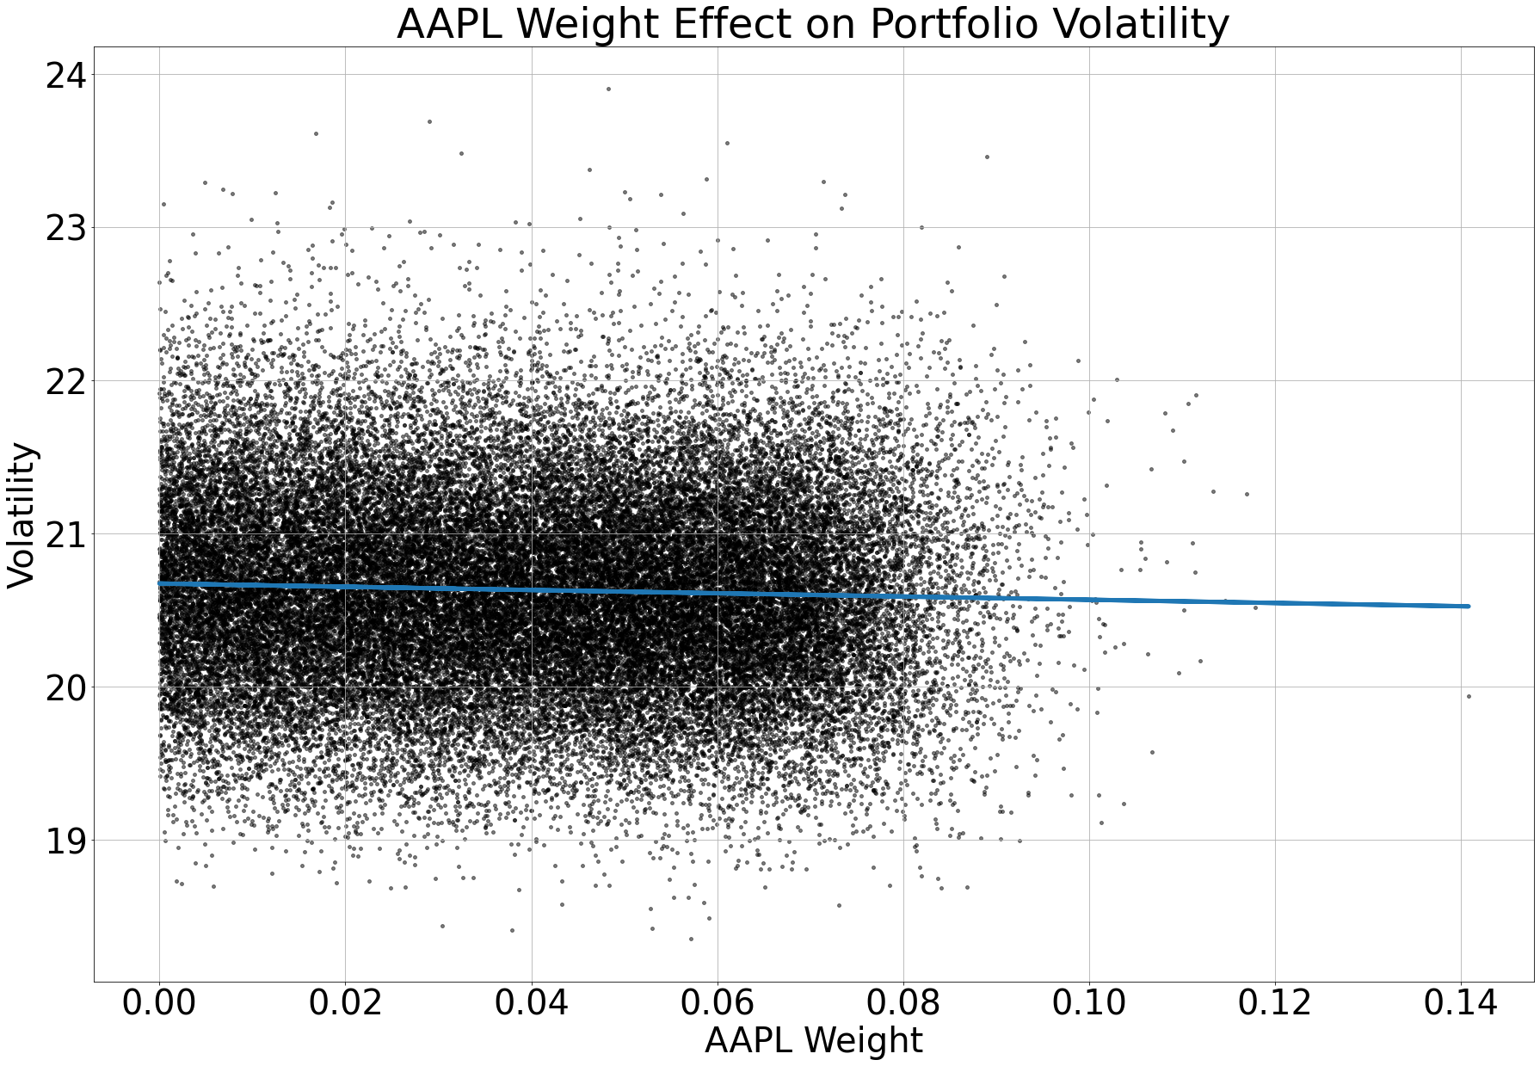
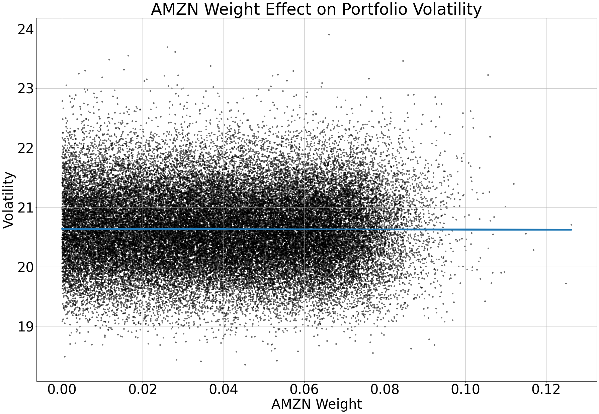
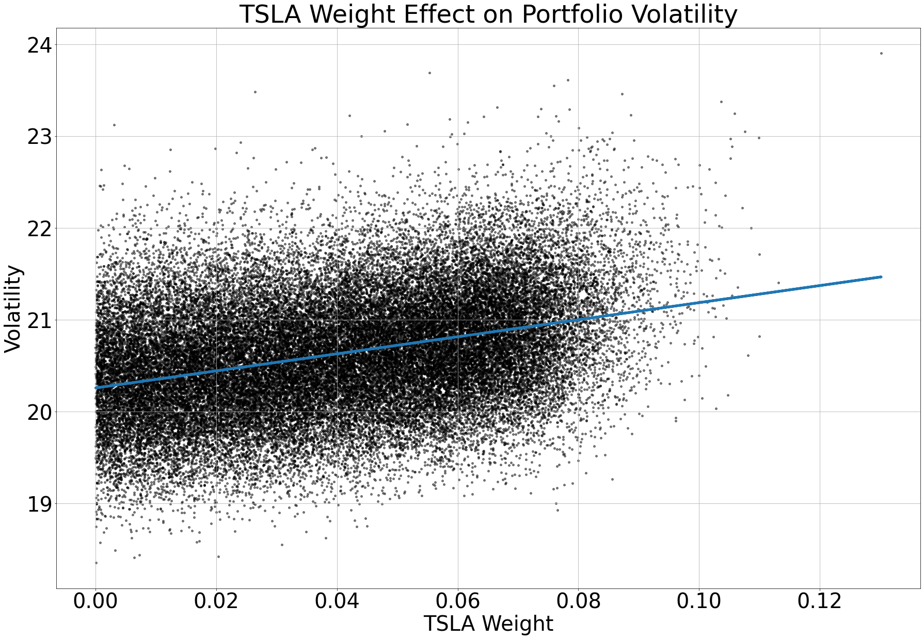
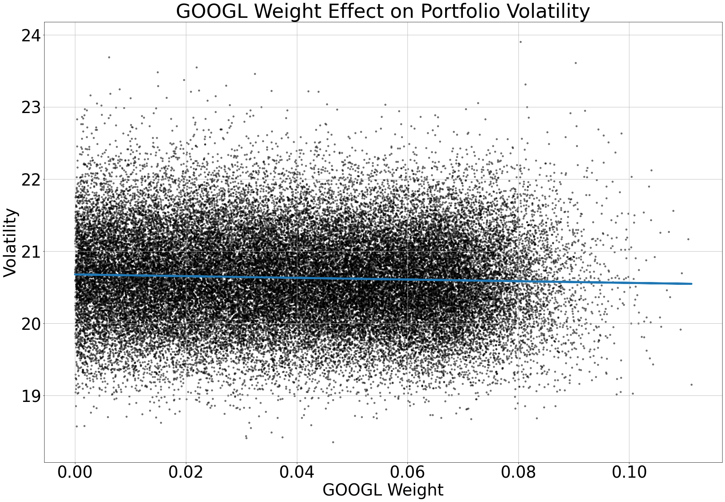
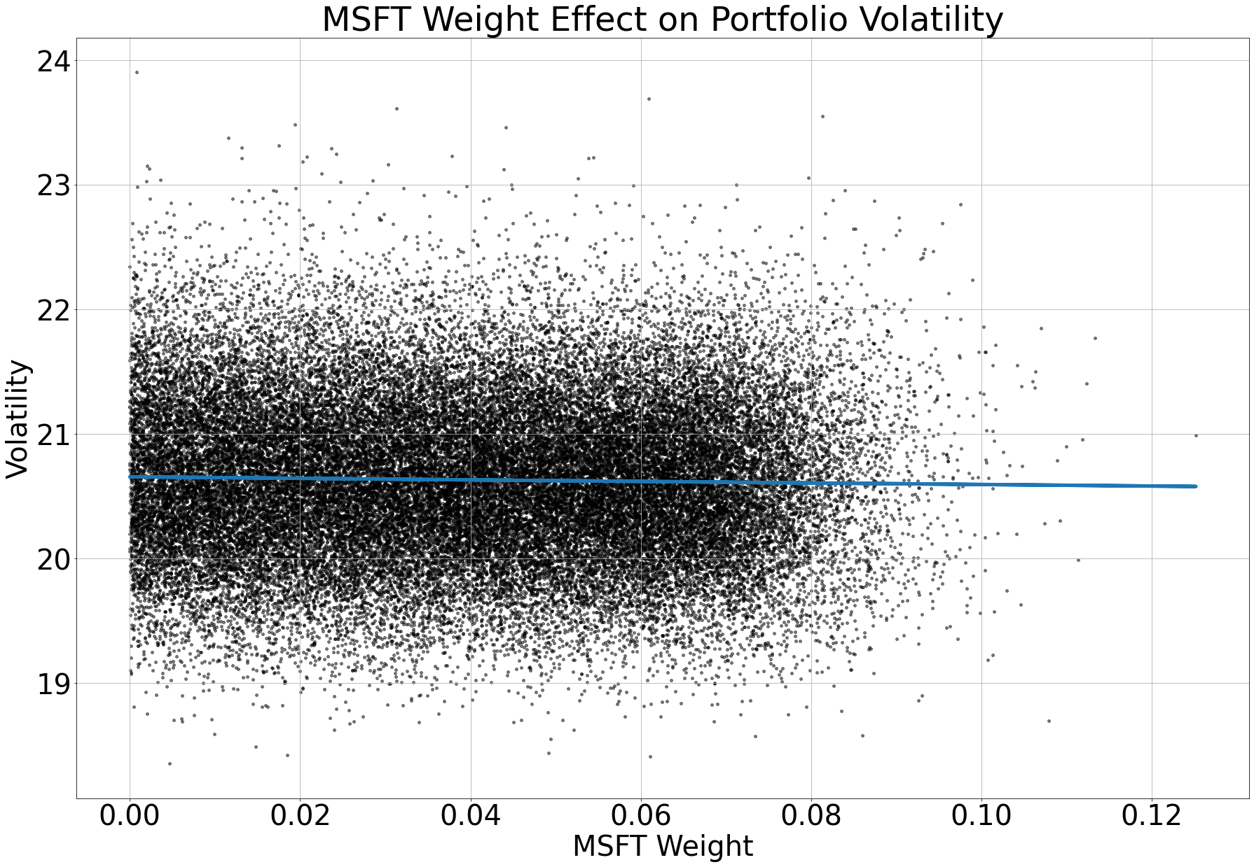
Individual Effects on Volatility
Similarly, to returns you want to see how much additional positions will add to total volatility
Obviously if you add more TSLA to your portfolio overall risk will increase and you’ll want to find the optimal risky portfolio, which is the Sharpe Ratio or Treynor Ratio

Slide 14
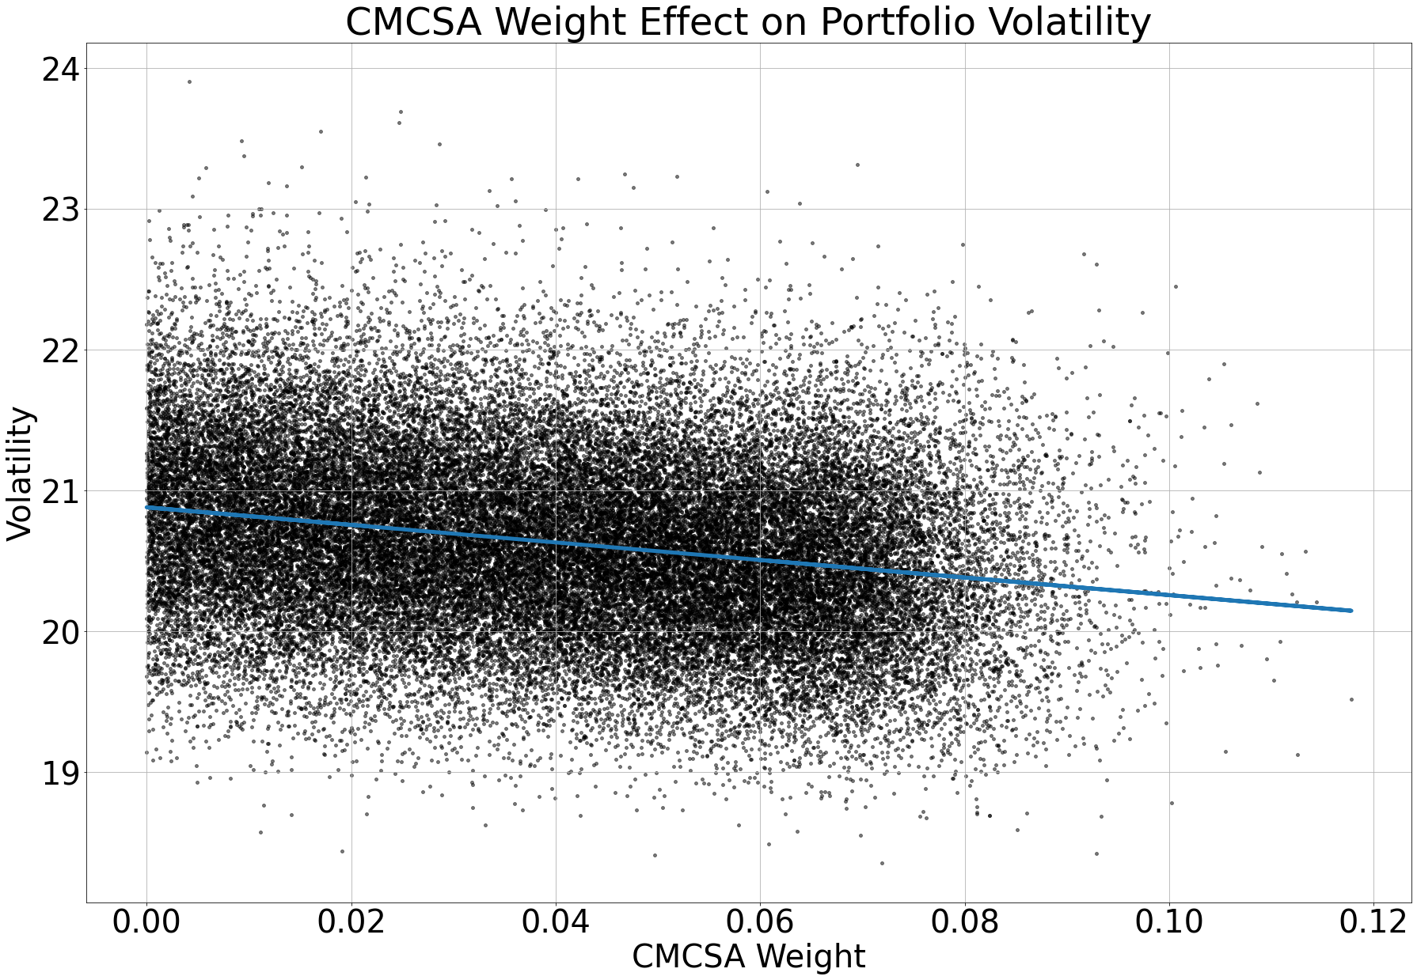
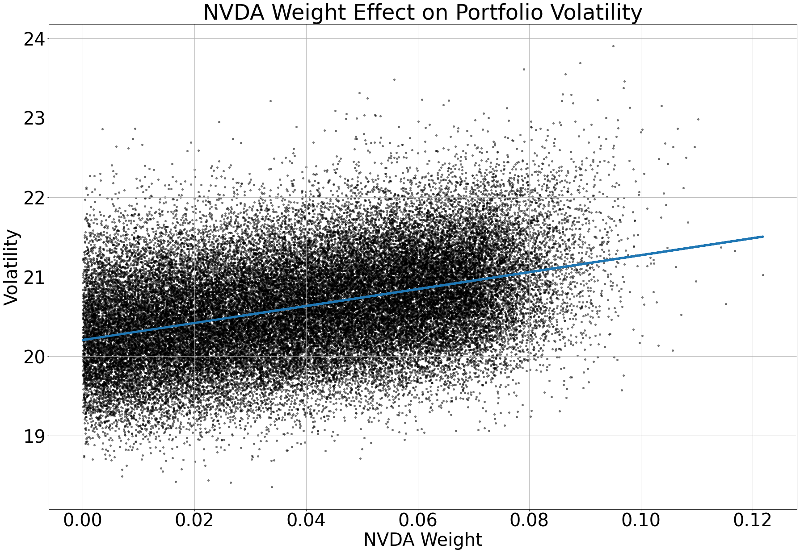
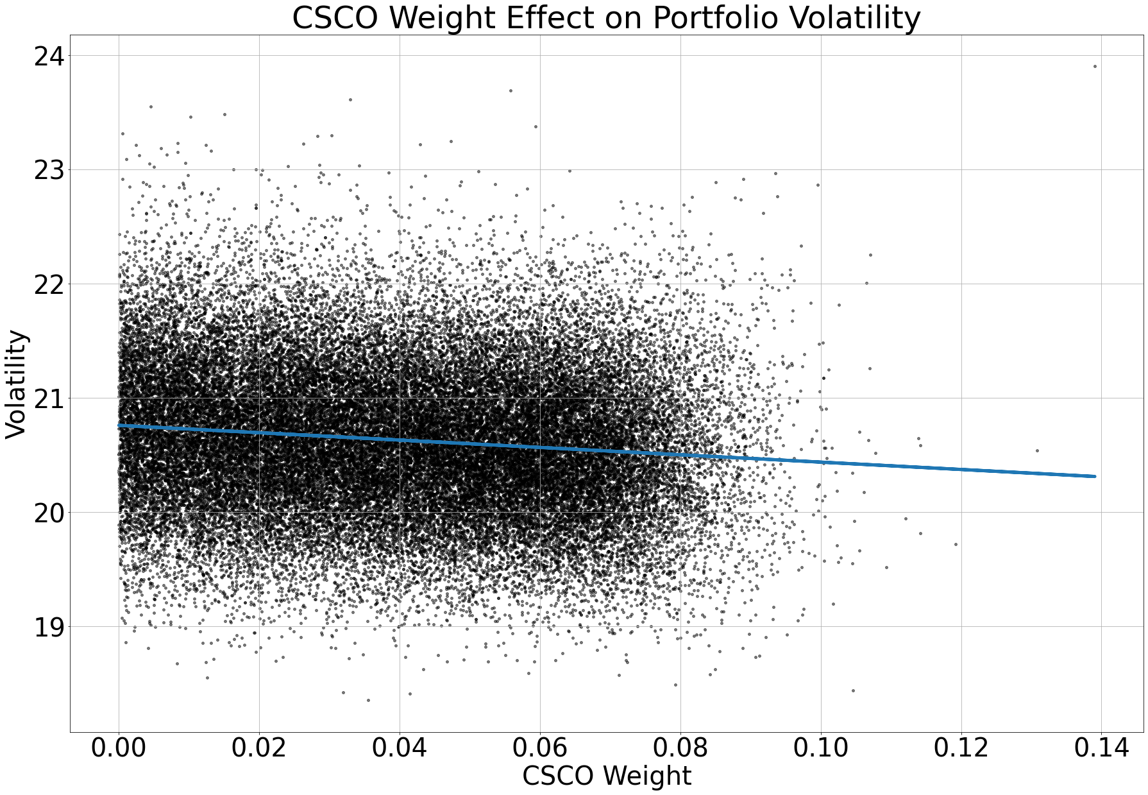
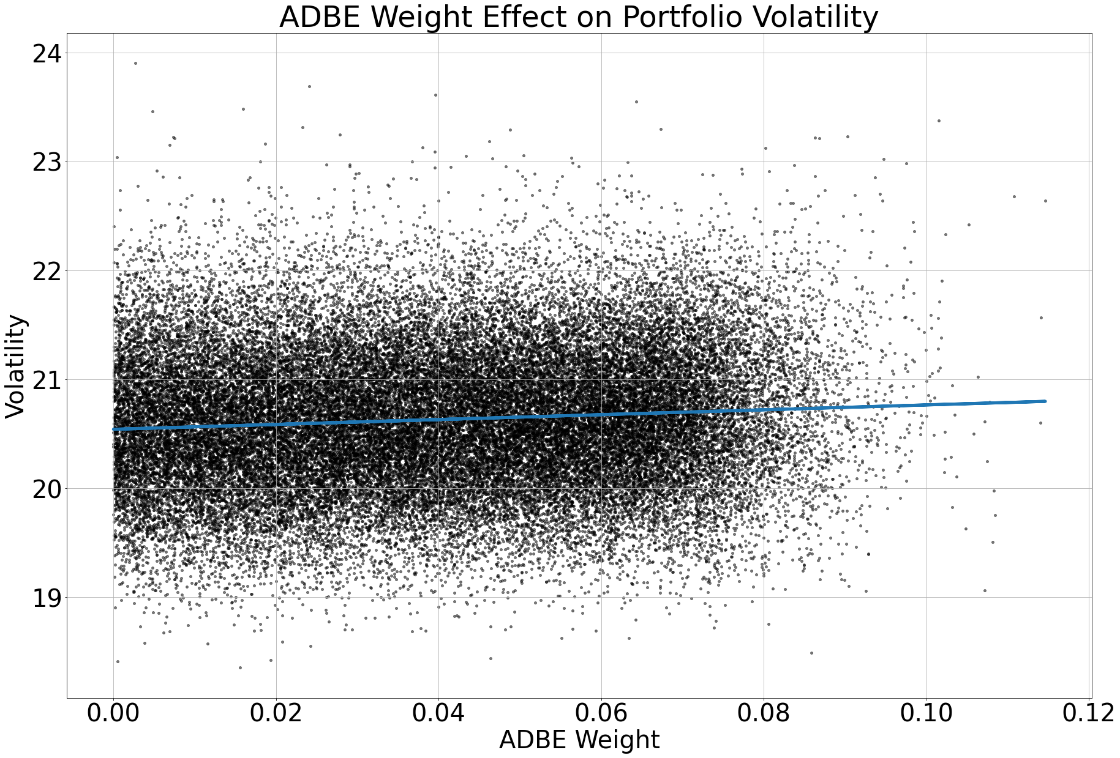
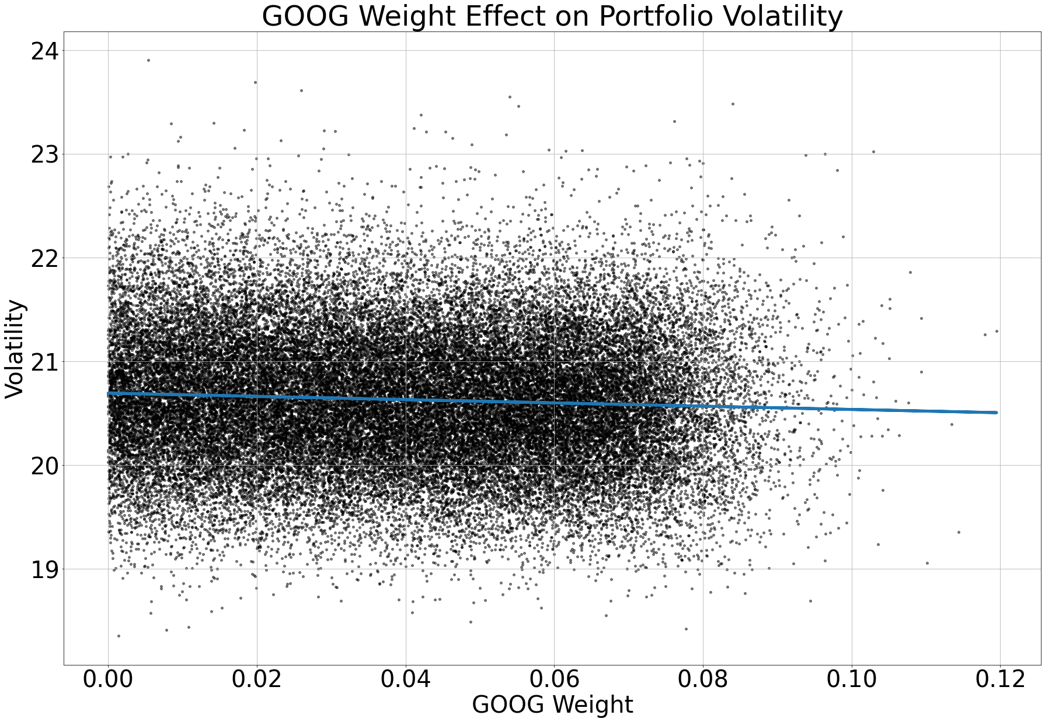
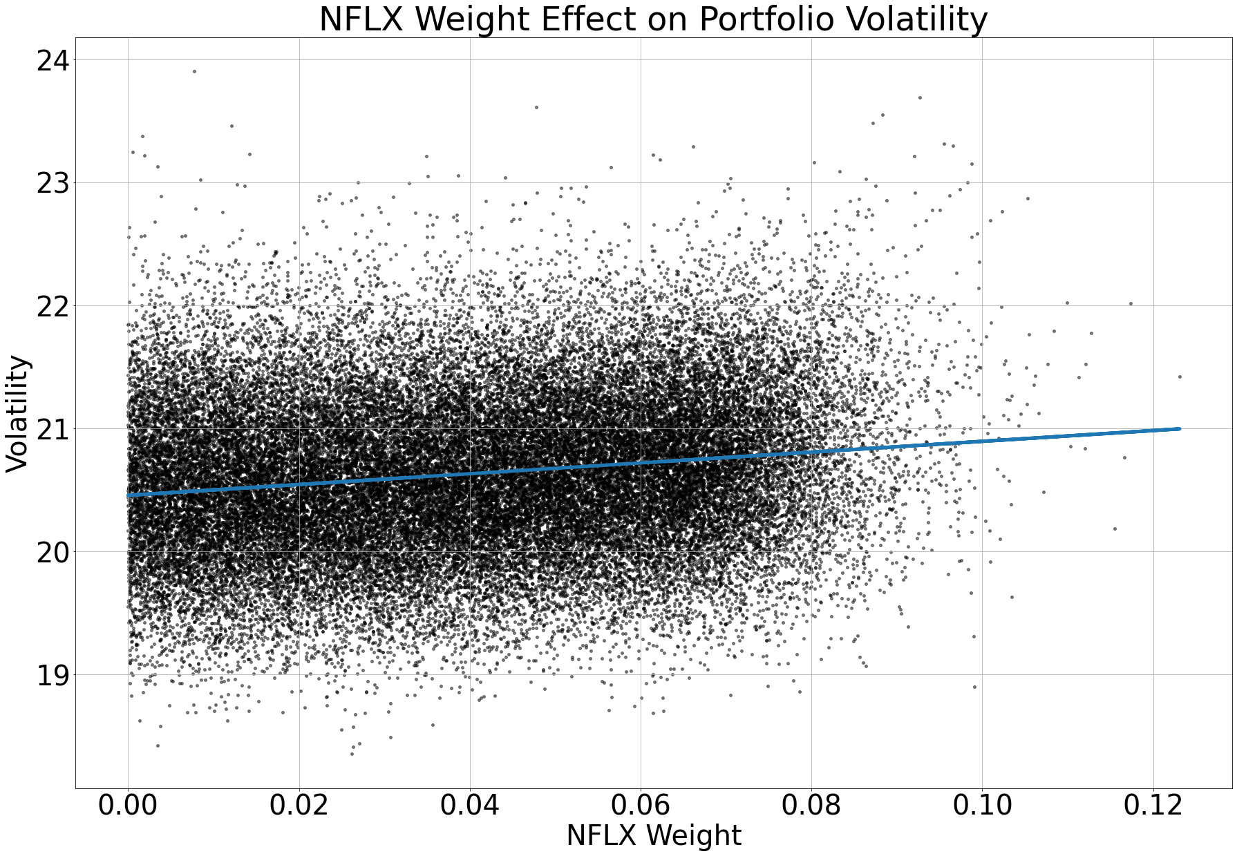
Individual Effects on Volatility
Similarly, to returns you want to see how much additional positions will add to total volatility
Obviously if you add more TSLA to your portfolio overall risk will increase and you’ll want to find the optimal risky portfolio, which is the Sharpe Ratio or Treynor Ratio

Slide 15
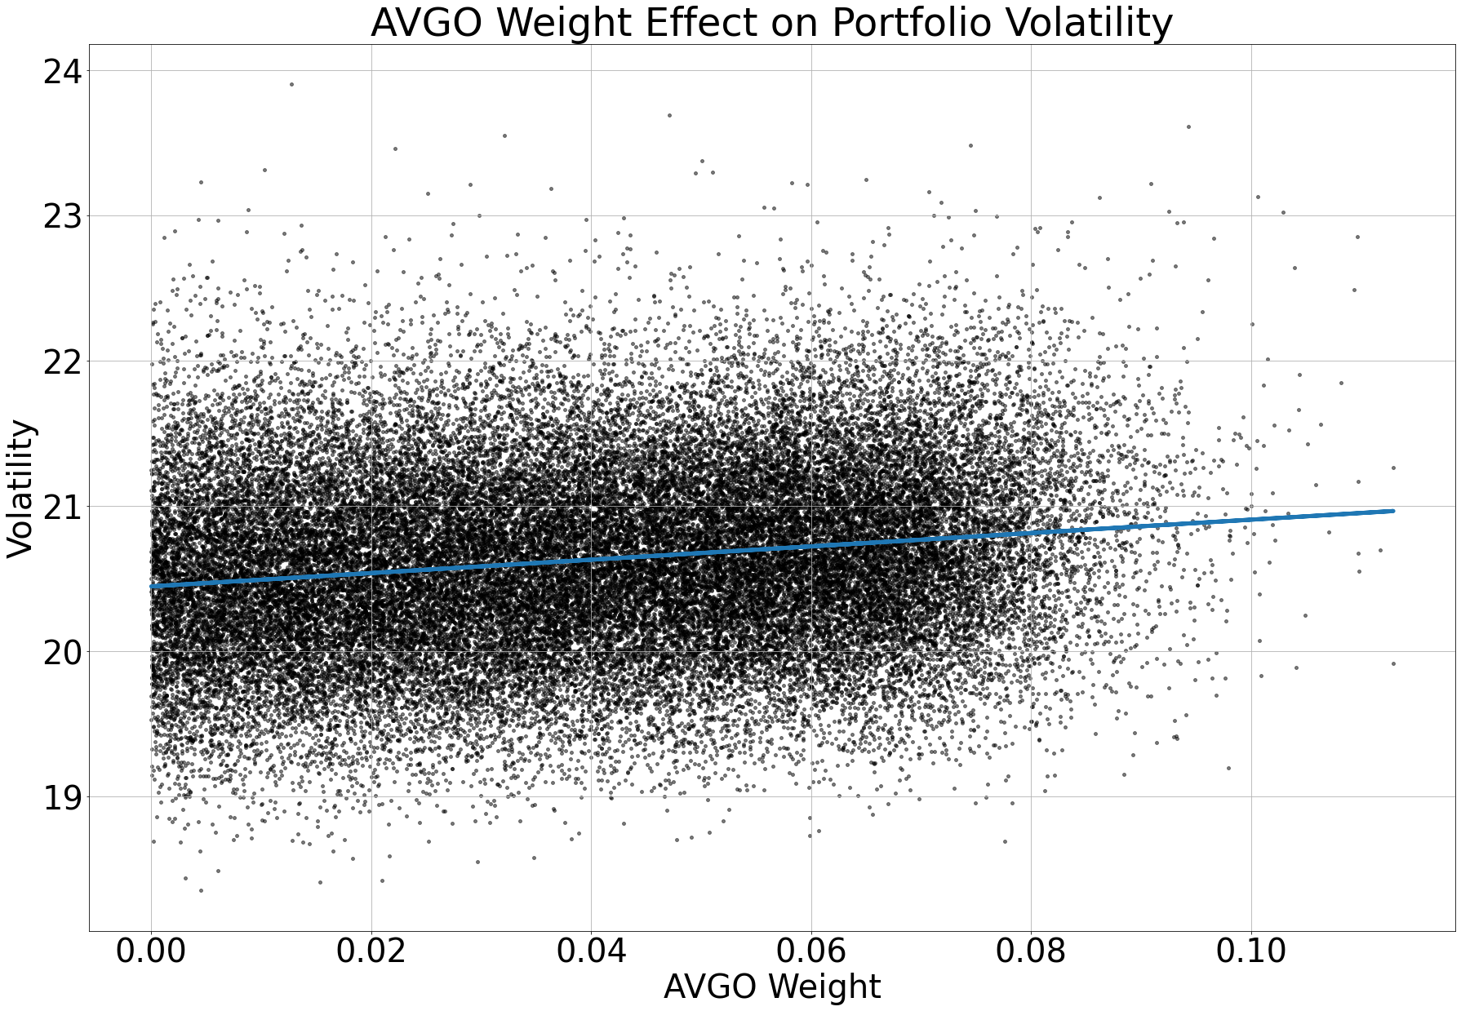
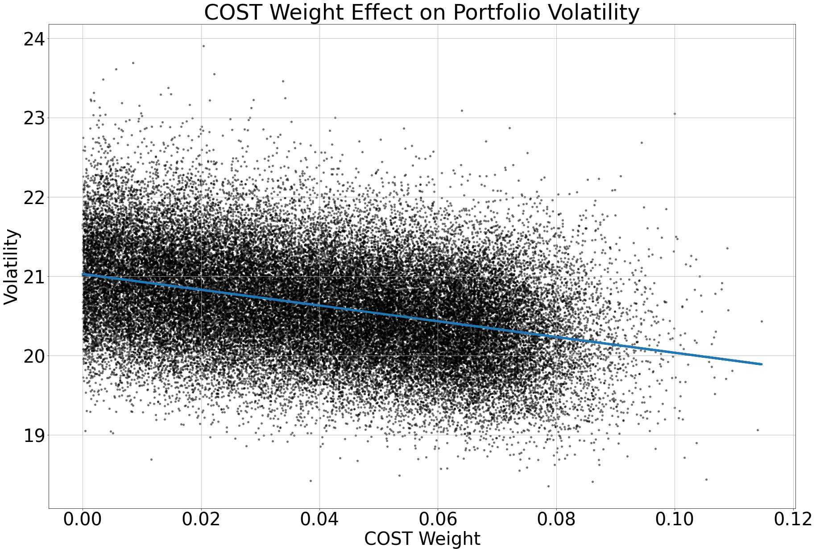
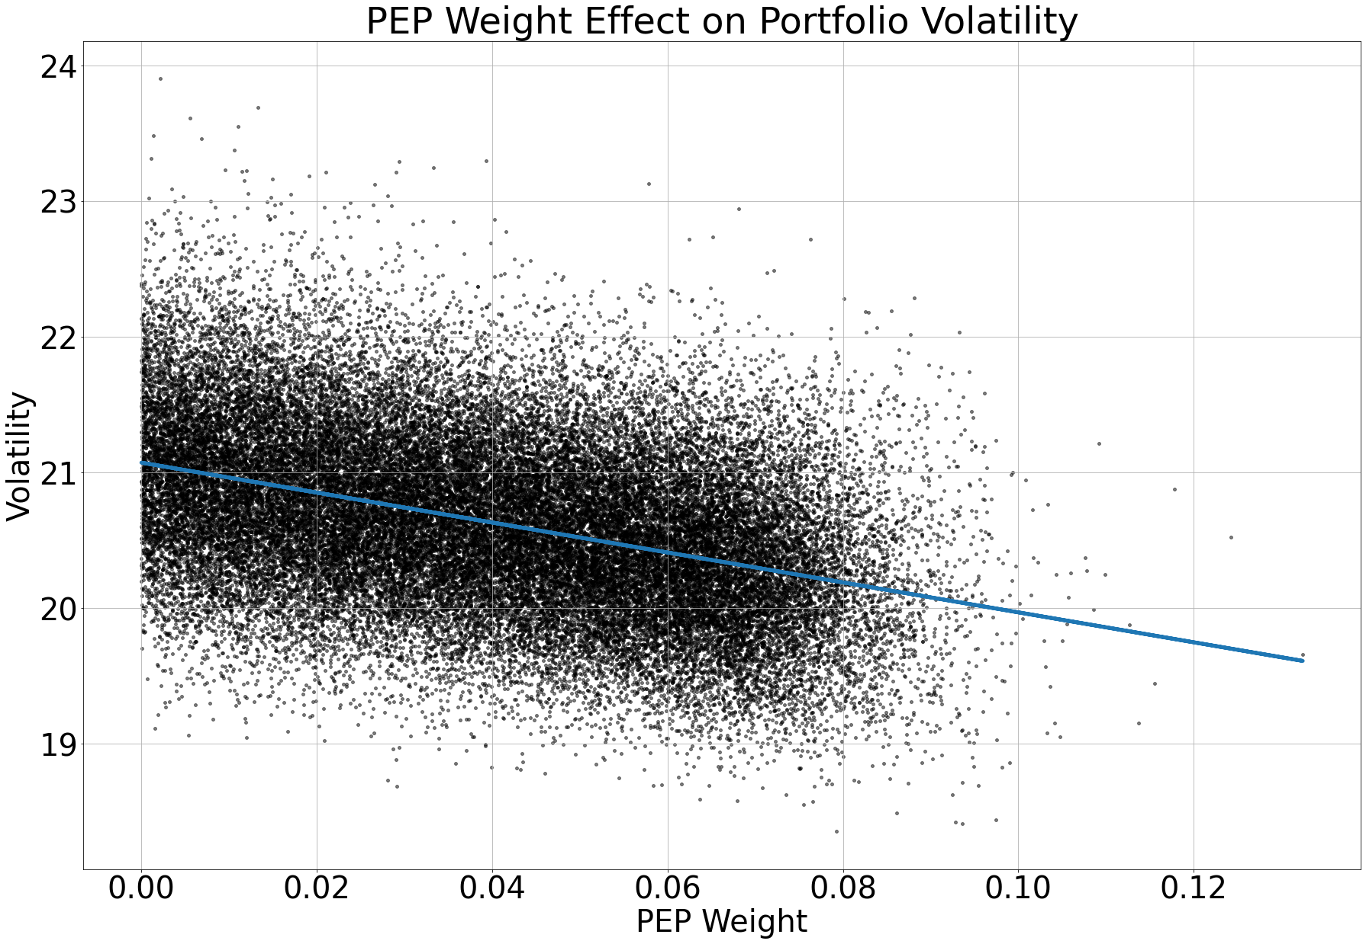
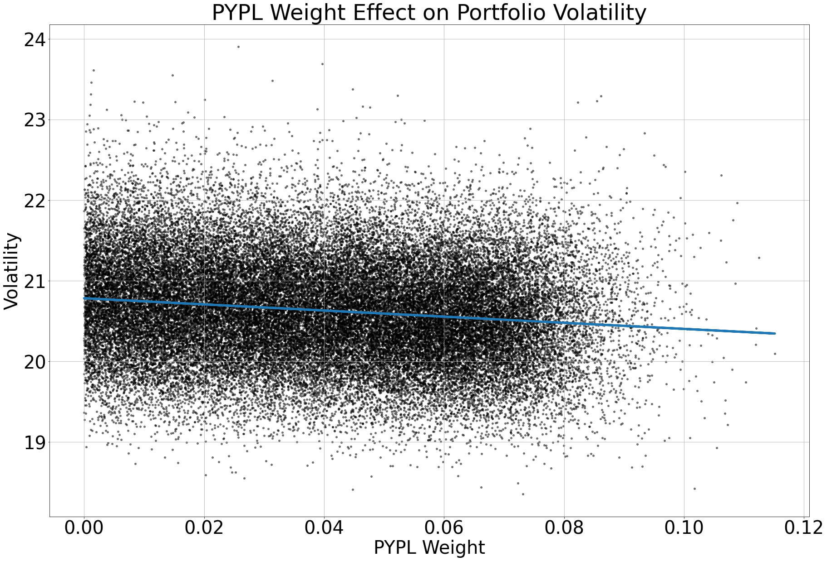
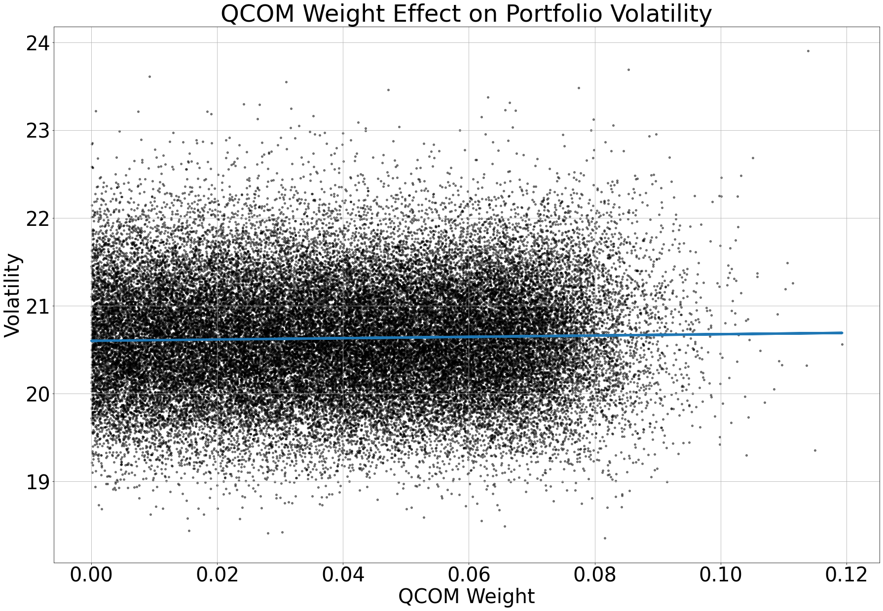
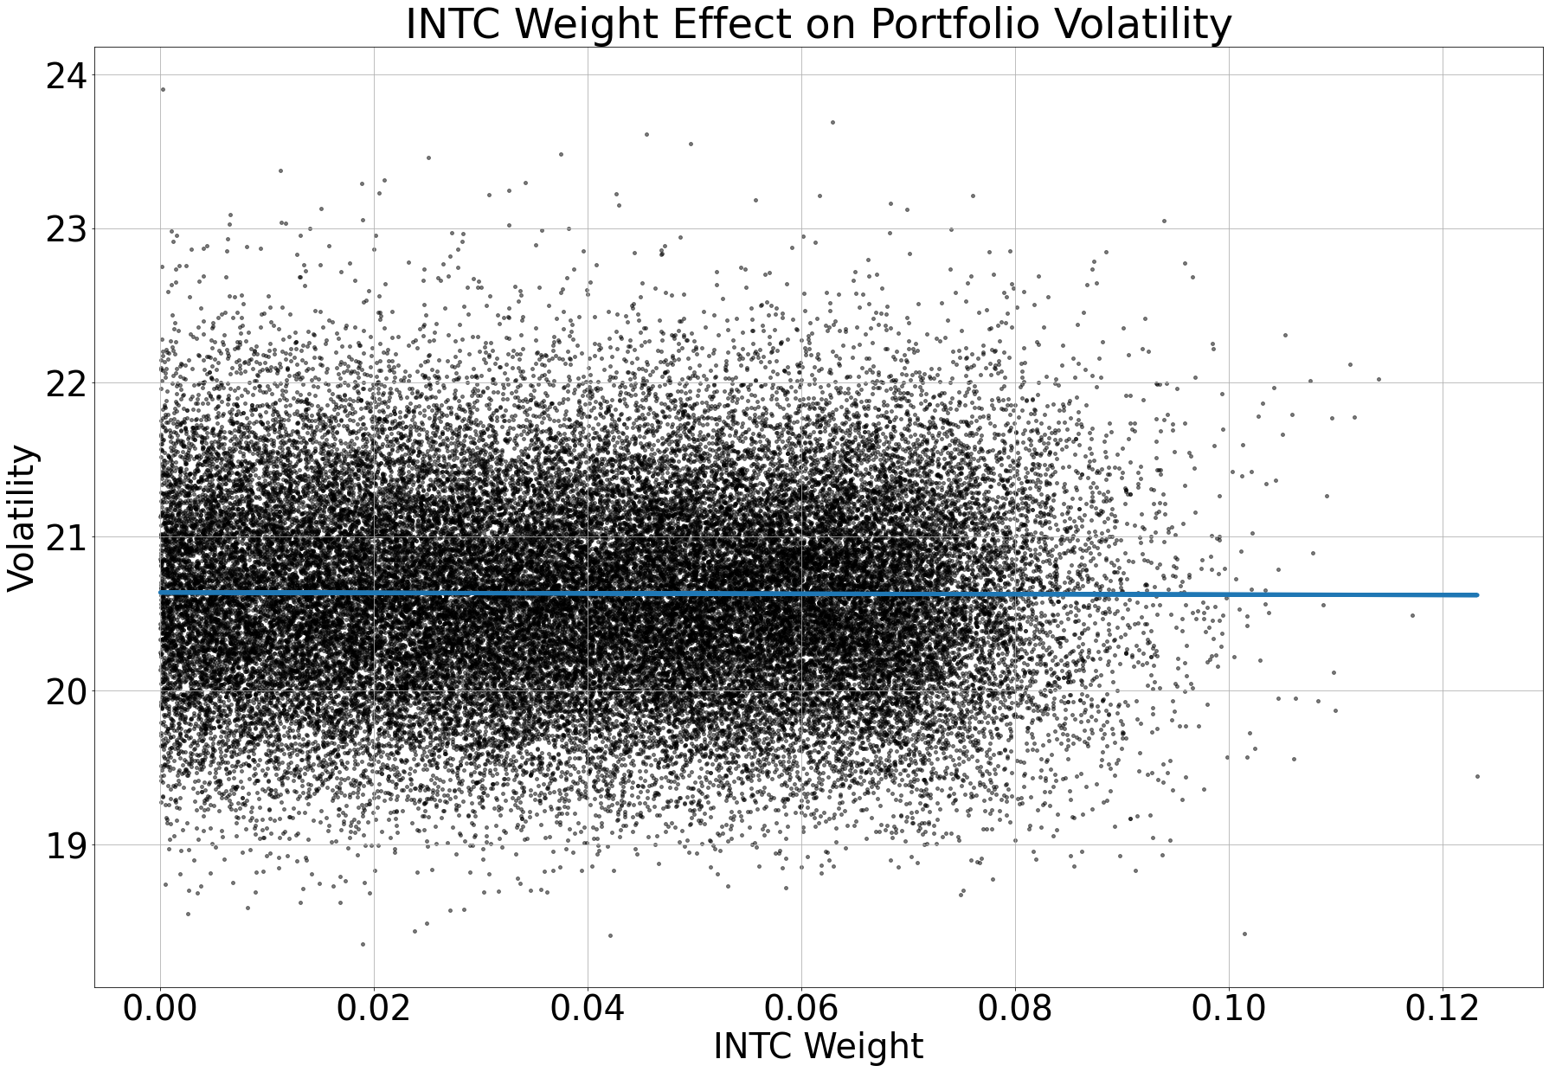
Individual Effects on Volatility
Similarly, to returns you want to see how much additional positions will add to total volatility
Obviously if you add more TSLA to your portfolio overall risk will increase and you’ll want to find the optimal risky portfolio, which is the Sharpe Ratio or Treynor Ratio

Slide 16
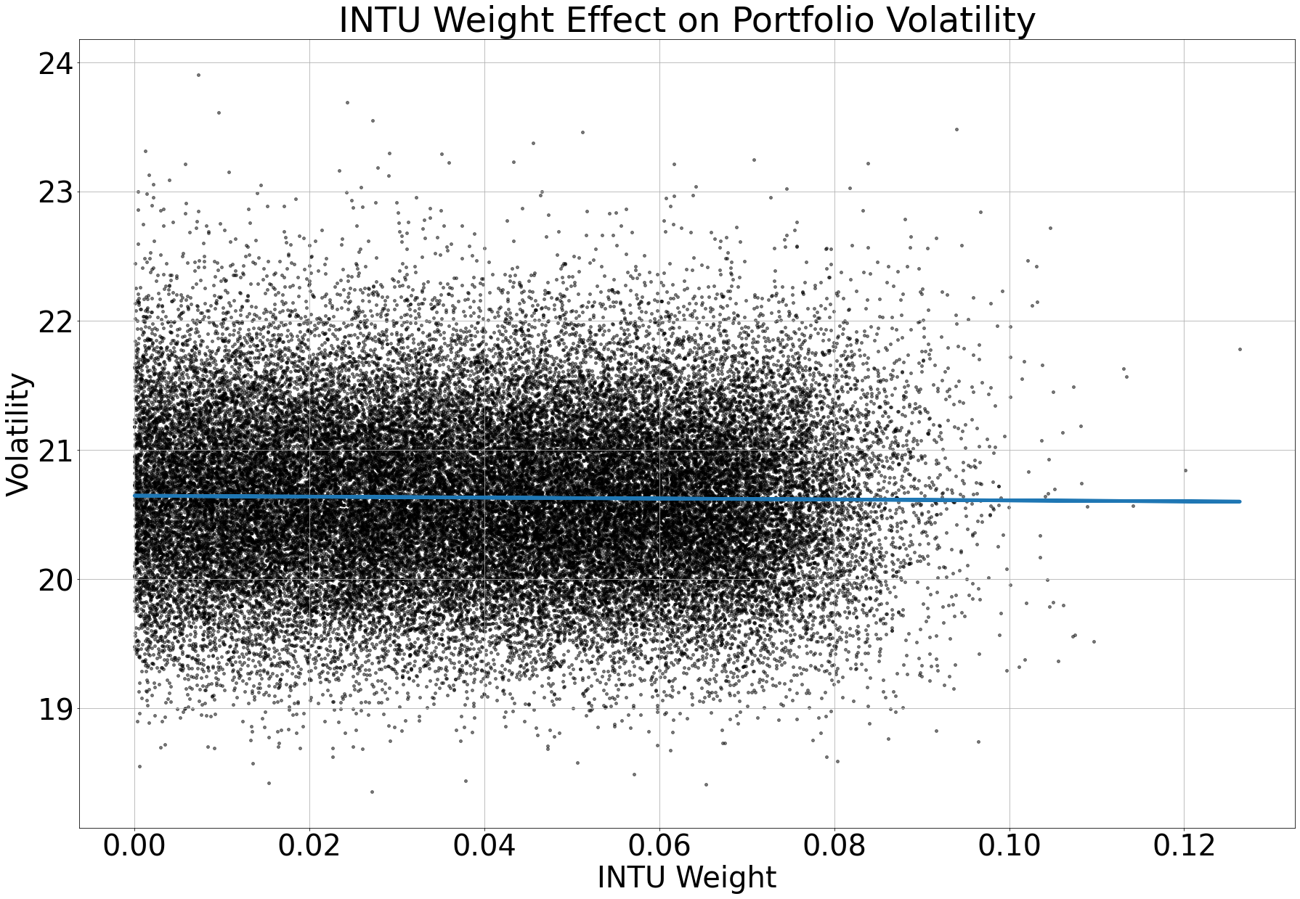
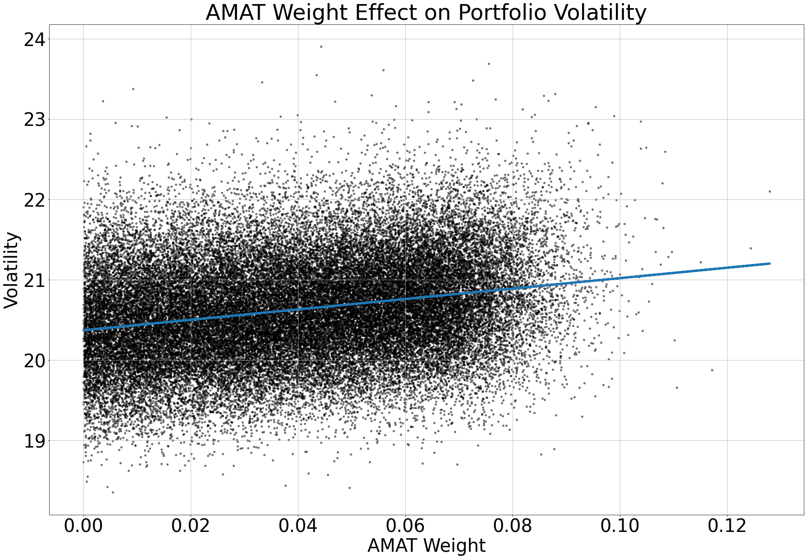
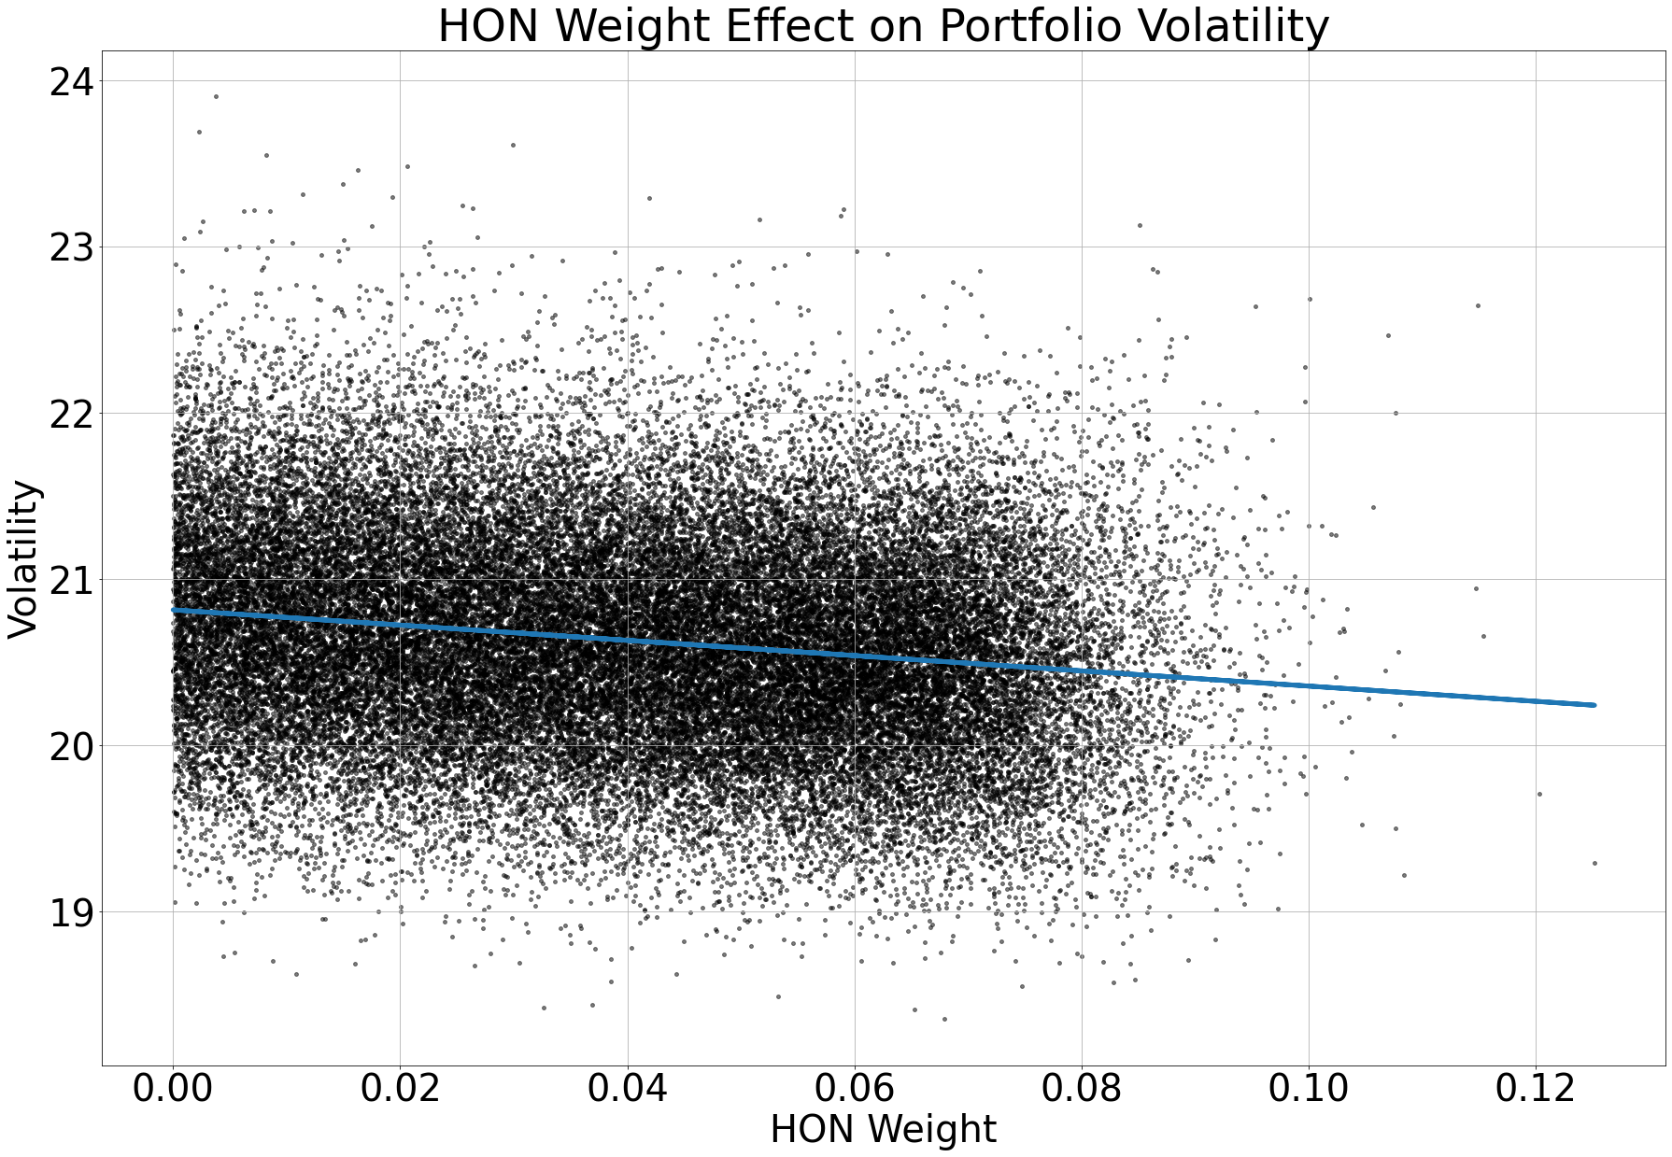
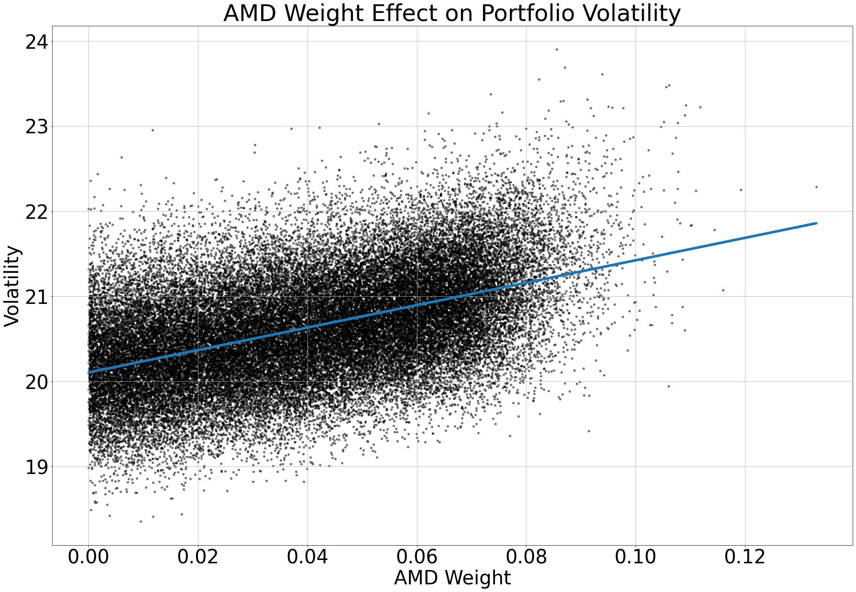
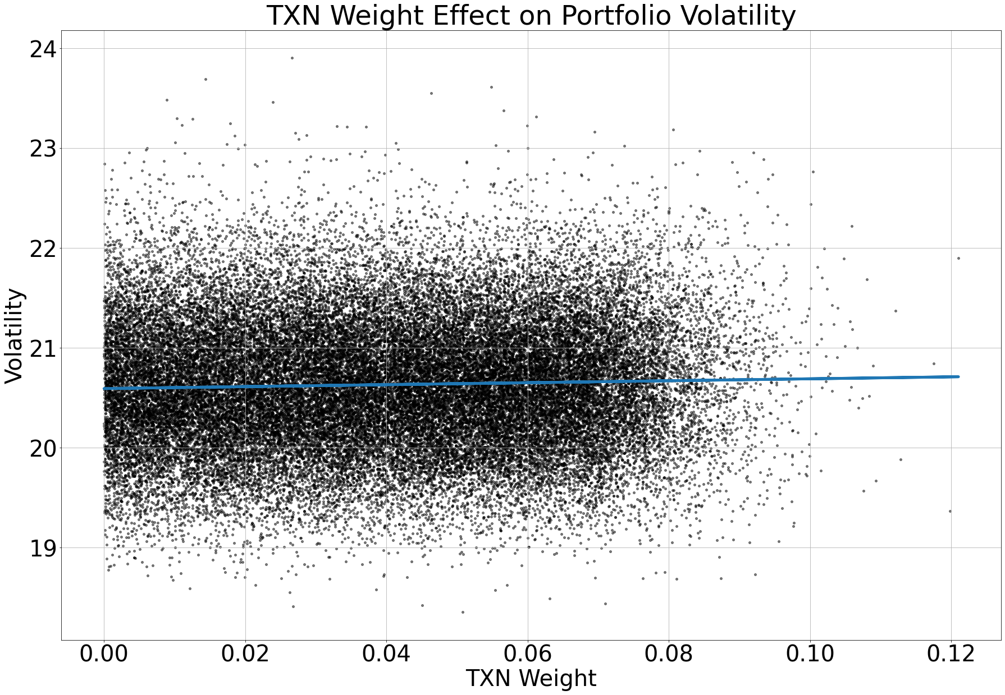
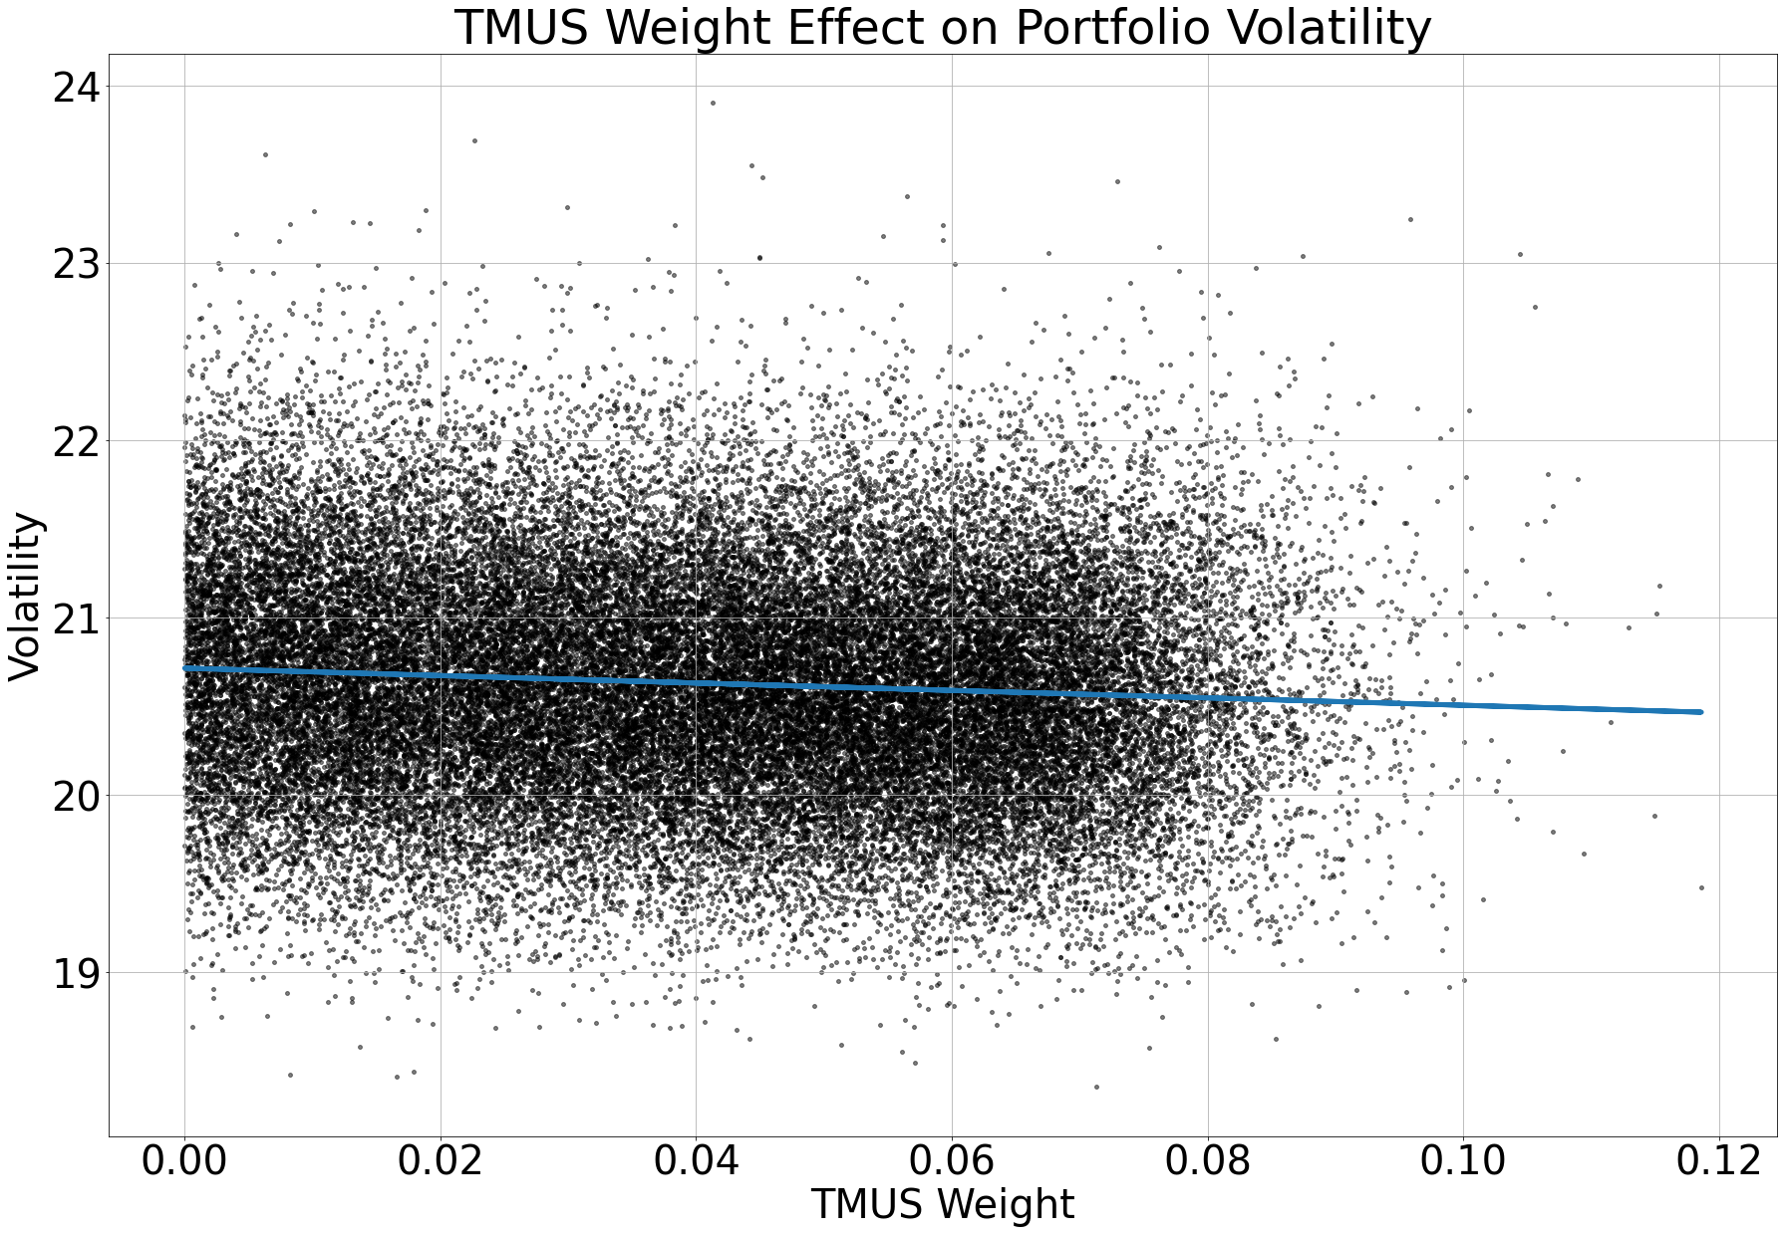
Individual Effects on Volatility
Similarly, to returns you want to see how much additional positions will add to total volatility
Obviously if you add more TSLA to your portfolio overall risk will increase and you’ll want to find the optimal risky portfolio, which is the Sharpe Ratio or Treynor Ratio

Slide 17

Individual Effects on Volatility
Similarly, to returns you want to see how much additional positions will add to total volatility
Obviously if you add more TSLA to your portfolio overall risk will increase and you’ll want to find the optimal risky portfolio, which is the Sharpe Ratio or Treynor Ratio

Slide 18

Constructing a Portfolio With Only Positive Effects on the Portfolio Sharpe Ratio

Slide 19

Portfolios with Value Stocks Only (VTV for Reference)
Sharpe Ratios: 2.02 1.07 2.56

Slide 20


Macroeconomic Indicators – Treasury Yield Curve

Slide 21

Macroeconomic Indicators - The US Dollar
Important for international asset allocation as a stronger dollar can hurt international trading
An important metric to look at with this is the effective federal funds rate, because as the rate increases the dollar is demanded more by foreigners, pension funds, etc. as they demand more treasuries

Slide 22

US Dollar Regression with Effective Federal Funds Rate

Slide 23

Macroeconomic Indicators – Leading Indicators
These measures help to determine the demand and supply of the economy before it happens
When these indicators decrease it could mean that products are being demanded less and therefor manufacturers require less supplies

Slide 24

RGDP Regression With Leading Indicators

Slide 25





Macroeconomic Indicators – Coincident Indicators
These indicators explain what is happening in the economy
Helpful for understanding the current economy and making future predictions

Slide 26

GDP Regression With Coincident Indicators

Slide 27

Retail Trading
One important thing that I think should be considered in the future is retail trading activity
Retail traders are generally more frequent traders which can affect volatility especially when traders are concentrated in one stock
Portfolio managers should avoid these high volatility retail stocks
One exception is TSLA, where index funds are required to hold TSLA because of its size in the market

Slide 28



Retail Trading Cases

Slide 29



Retail Trading Regressions
Ticker: AMZN GME TSLA

Slide 30
Conclusion
One additional thing that I didn’t necessarily go into was individual security selection – when selecting securities understanding it’s fundamentals and strategy and have conviction on it
When constructing a portfolio its important for me to understand each of these topics that I have touched on and that additional part above
This helps me to understand my risk tolerance and the risk tolerance of clients to help inform my decisions of client and personal portfolios
The numbers are clearly there for added conviction and how to allocate specific assets in your best interest
Understanding the individual effects also is a great consideration as that can skew your optimal portfolio away from your risk profile

